Slide 1
Microarchitectural Weird Machines
Yuval Yarom
Ruhr University Bochum

Slide 2
Publications
The Gates of Time: Improving Cache Attacks with Transient Execution
Daniel Katzman
William Kosasih
Chitchanok Chuengsatiansup
Eyal Ronen
Spec-o-Scope: Cache Probing at Cache Speed
Gal Horowitz
Eyal Ronen

Slide 3
Emergent Behaviour

Slide 4
Emergent Behaviour
Game of life
A cell is born if it has 3 neighbours; survives if it has 2 or 3.
Emergent behaviour:
Unintended side effect of a system

Slide 5
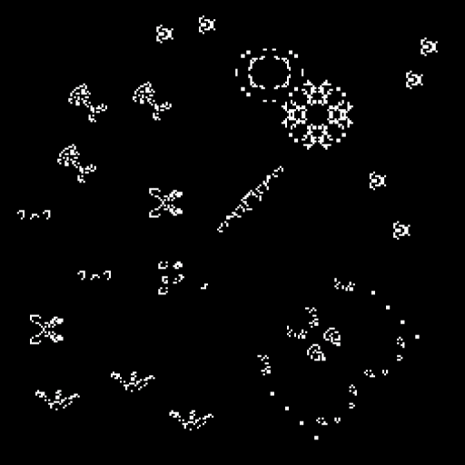
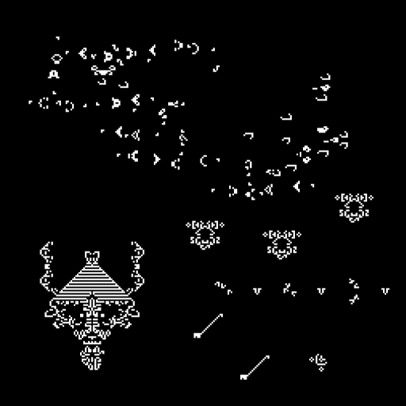
More examples
From: https://experiments.withgoogle.com/conway-game-of-life

Slide 6
The memory wall
Processors are fast
Memory is slow
Slows execution when waiting for data
Cache: a small bank of fast memory Exploit locality to improve performance
Stores recently accessed data for quick future access
Processor
Cache
Memory
Notes:
Another thing that changed since my Apple // days is the processor speed. My apple 2 ran at 1 MHz. My mac runs at 2GHz. Memory speed, however, has not fared so well. The memory on my apple needed half a clock cycle to produce data, whereas modern computers require about 200. When the processor reads from memory it needs to wait. <click> and if it needs to read from the same location again it needs to wait again. <click>. So, we have a speed gap between the processor and the memory.
The cache is the part of the processor that bridges this gap. It is a small memory that is included within the processor. Being small, being closer to the execution core and using more expensive technologies than the main memory mean that the cache is much faster than the memory. On intel the spead ranges from 4 to 50 cycles, depending on the level of cache.
Yada yada

Slide 7
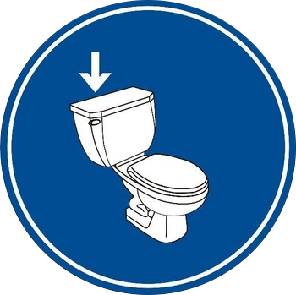
Cache operations
Accessing memory brings it to the cache
Flushing memory evicts it from the cache

Slide 8
Emergent behaviour
Measuring access time tells us whether a location is cached or not

Slide 9
Cache construction
Arranged as matrix
Memory locations mapped to sets
Can be stored in any of the ways of the set
Replacement policy decides where
Ways
Sets

Slide 10
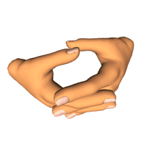
More Emergent Behaviour
Fill a cache set with data
Wait a bit
Measure access time to data
Can monitor other programs!

Slide 11
Logical State of Cache
Associate a logical value with memory addresses
TRUE – address is cached
FALSE – address is not cached
Flushing sets a value to FALSE
Accessing memory sets a value to TRUE (may also set another to FALSE)
Measuring access time observes value (and set to TRUE)
What else?
Processor
Cache
F F F T F F F F T F F F F
F
T
Memory

Slide 12
Conditional access
if (*in == 0)
return;
out *= 1;
out *= 1;
a = *out
What is the cache state of *out after execution?
TRUE if *in != 0.
What if *in == 0?
Assume *in == 0

Slide 13
Speculative execution
Assume
*in == 0
if (*in == 0)
return;
out *= 1;
out *= 1;
a = *out
Evaluation of branch conditions can take time
The CPU predicts future execution
Correct prediction – win
Incorrect prediction – rollback
Microarchitectural state remains
Assume branch mispredicted
May be executed even if *in == 0

Slide 14
Conditional Speculative Execution
Assume
*in == 0
Branch mispredicted
if (*in == 0)
return;
out *= 1;
out *= 1;
a = *out
Load *in
Delay
Load *in
Delay
branch
Load *out
Load *out
branch
*in cached
*in not cached

Slide 15
Weird NOT gate
Assume
*in == 0
Branch mispredicted
if (*in == 0)
return;
out *= 1;
out *= 1;
a = *out
Load *in
Delay
Load *in
Delay
branch
*in | *out
TRUE | FALSE
FALSE | TRUE
Load *out
Load *out
branch
out ← NOT(in)
*in cached
*in not cached

Slide 16
Thinking about this
Probe
Load *in
Delay
Delay
branch
Control
Load *out
Signal
Chains

Slide 17
Combining Chains
if (*in1 + *in2 == 0)
return;
out *= 1
a = *out
Load *in1
Load *in2
Delay
*in1 | *in2 | *out
FALSE | FALSE | TRUE
FALSE | TRUE | TRUE
TRUE | FALSE | TRUE
TRUE | TRUE | FALSE
Load *out
branch
out ← NAND(in1, in2)

Slide 18
Multiple control chains
if (*in1 == 0)return;
if (*in2 == 0)return;
out *= 1
a = *out
Load *in2
Load *in1
Delay
*in1 | *in2 | *out
FALSE | FALSE | TRUE
FALSE | TRUE | FALSE
TRUE | FALSE | FALSE
TRUE | TRUE | FALSE
branch
Load *out
branch
out ← NOR(in1, in2)

Slide 19
Non-decreasing functions
if (delay()== 0)
return;
t1 = *in1
t2 = *in2;
a = *(out + t1 + t2)
Delay
Load *in1
Load *in2
*in1 | *in2 | *out
FALSE | FALSE | FALSE
FALSE | TRUE | FALSE
TRUE | FALSE | FALSE
TRUE | TRUE | TRUE
branch
Load *out
out ← AND(in1, in2)

Slide 20
OR gates (Adapted from Wang et al., WOOT 2023)
if (delay()== 0)
return;
a = *(out + *in1)
a = *(out + *in2)
Delay
Load *in1
Load *in2
*in1 | *in2 | *out
FALSE | FALSE | FALSE
FALSE | TRUE | TRUE
TRUE | FALSE | TRUE
TRUE | TRUE | TRUE
Load *out
branch
Load *out
out ← OR(in1, in2)

Slide 21
Replicator
if (delay()== 0)
return;
t = *in
a = *(out1 + t)
a = *(out2 + t)
...
a = *(outn + t)
Delay
Load *in
Load *out1
Load *out2
branch

Slide 22
Composing more – multiple output NAND
if (*in1 + *in2 == 0)
return;
t = delay()
a = *(out1 + t)
a = *(out2 + t)
Load *in1
Load *in2
Delay
Load *out1
Load *out2
branch

Slide 23
Minority Report
*in1 | *in2 | *in3 | *out
FALSE | FALSE | FALSE | TRUE
FALSE | FALSE | TRUE | TRUE
FALSE | TRUE | FALSE | TRUE
FALSE | TRUE | TRUE | FALSE
TRUE | FALSE | FALSE | TRUE
TRUE | FALSE | TRUE | FALSE
TRUE | TRUE | FALSE | FALSE
TRUE | TRUE | TRUE | FALSE
if (*in1 + *in2 == 0)
return;
if (*in2 + *in3 == 0)
return;
if (*in1 + *in3 == 0)
return;
a = *out

Slide 24
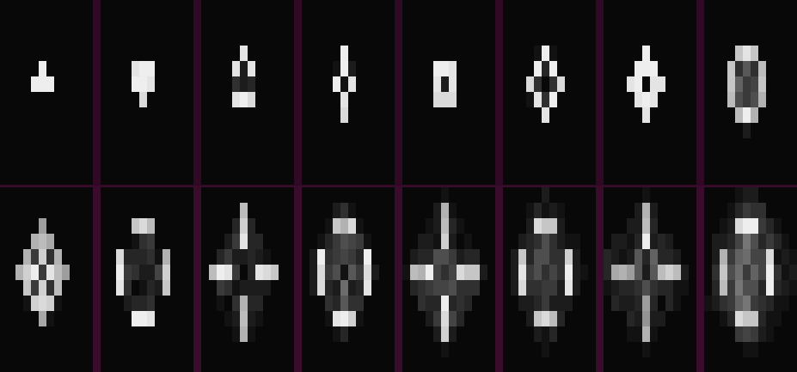
Circuits
4-bit ALU
1258 gates, 84-95% accuracy
SHA-1
One round: 2208 gates, 95% accuracy (67% with prefetcher)
Full (two blocks, with repetitions) 95% accuracy
Game of Life
7807 gates 73% accuracy for one generation, 25% for 20

Slide 25
The Flush+Reload Attack [YF14]
Flush a memory line from the cache
Wait a bit
Measure time to load line
slow-> no access
fast-> access
Repeat
Cache
Memory
Notes:
Reminder: Fast 50 cycles. Slow 200. Measurement adds about 30 cycles.
Wrap-up – the weakness is that the spy can monitor access to shared memory lines and consequently infer information about the data the victim processes

Slide 26
The RSA Encryption System
The RSA encryption is a public key cryptographic scheme
M
M = C^{d} mod N
C
C = Me mod N
Key Generation:
Select random primes p and q
Calculate N = pq
Select a public exponent e(=65537)
Compute d=e⁻¹ mod φ(N)
(N, e) is the public key
(p, q, d) is the private key

Slide 27
Square and Multiply Exponentiation
x ⟵1
for i ⟵|d|-1 downto 0 do
x ⟵x² mod n
if (d_{i} = 1) then
x = xC mod n
endif
done
return x
Operation | x | i | d_{i}
 | 1 | 2 | 101
Square | 1 | 2 | 101
reduce | 1 | 2 | 101
Multiply | 11 | 2 | 101
reduce | 11 | 2 | 101
Square | 121 | 1 | 101
reduce | 21 | 1 | 101
Square | 441 | 0 | 101
reduce | 41 | 0 | 101
Multiply | 451 | 0 | 101
reduce | 51 | 0 | 101
The private key is encoded in the sequence of operations !!!
Example:
11⁵ mod 100 =
161,051 mod 100 = 51
Notes:
Old implementation – not in use

Slide 28
Flush+Reload on Square-and-Multiply
Typical Clock Rates
Chrome 0.1ms
Safari 1ms
Firefox 2ms
TOR 100ms
Apple M1 42 ns
40ns

Slide 29
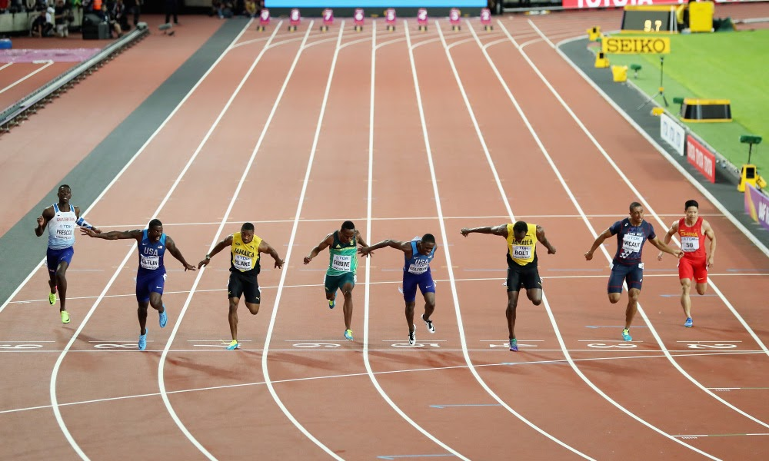
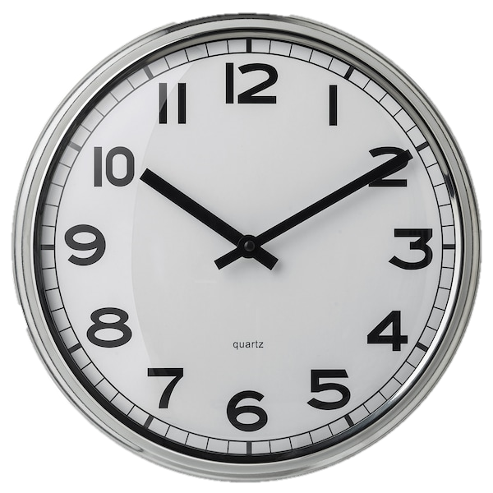
Reducing Timer Resolution
Measure this
With this

Slide 30
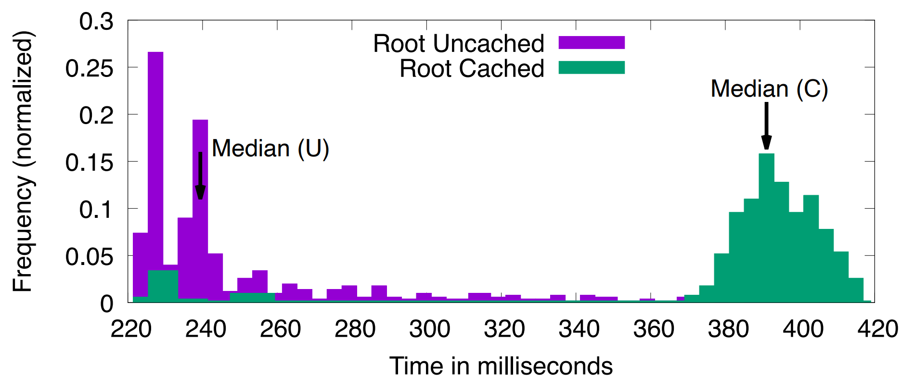
Amplification
if (*in == 0)
return;
a = *out1 + *out2 +
*out3 + *out4 +
*out5 + *out6 +
*out7 + *out8;
A NOT gate with a large fan-out amplifies the signal by a factor of 8
Two layers – 64
Three layers – 512
Four layers – 4096
Amplify to a resolution of 0.1 second

Slide 31
Amplification is half the job
40ns
25us

Slide 32
Prime+Probe is NAND

Slide 33
Prime+Probe is NAND

Slide 34
Prime+Store: High Resolution Prime+Probe
Probe is basically a NAND gate
Do multiple probes of the same cache set. Store results.
Amplify later
Decouples probing from time measurements
Attack square-and-multiply ElGamal with a 0.1ms clock

Slide 35
How Fast can we Probe?

Slide 36
How fast can we probe?
Probing the cache takes time
Limited temporal resolution
Thousands of cycles
Prime+Scope (CCS 2021) – 70 cycles.

Slide 37
Prime+Scope code
5 cycles
uint32_t scope(char * address) {
uint32_t start = rdtscp();
char t = *address;
uint32_t end = rdtscp();
return end – start;
}
30 cycles
5 cycles
30 cycles
Measuring time is an order of magnitude slower than a cache access

Slide 38
Using Prime+Store
Prime+Store is a hammer – let’s try it on this nail.
Result: 150 cycles – branch training is not cheap

Slide 39
Return-based gates (Kaplan 2023)
void NOTGate(char *out, char *in) {
setret(((uintptr_t)&&out) + *in);
out *= 1;
out *= 1;
t = *out;
lfence();
out:
}
Load *in
Delay
return
setret:
mov %rdi, (%rsp)
ret
Load *out

Slide 40
Using Prime+Store
Prime+Store is a hammer – let’s try it on this nail.
Result: 150 cycles – branch training is not cheap
Prime+Store with RET-based gates: 48 cycles.
48 < 70 Yay!
48 is still very slow

Slide 41
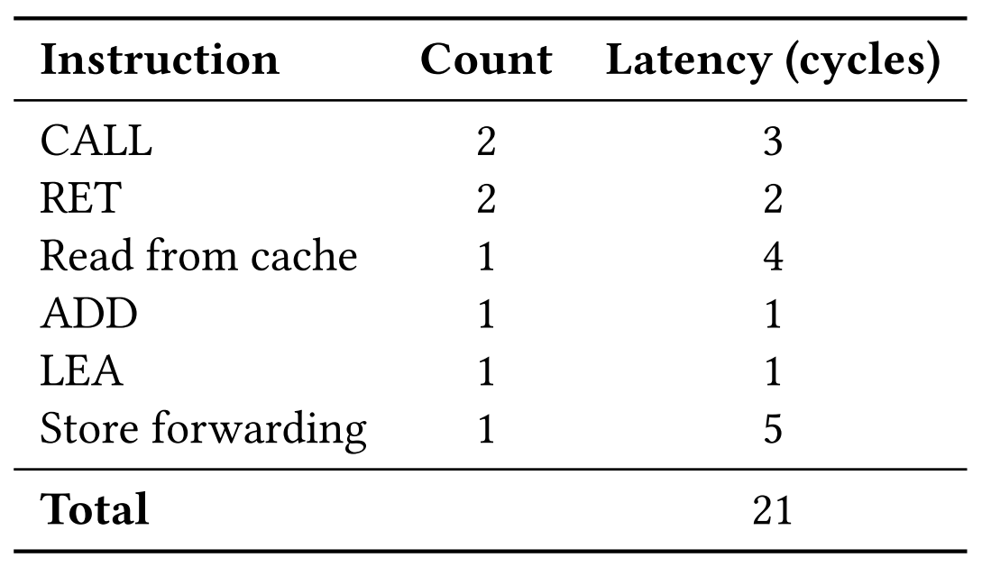
Timing analysis
void NOTGate(char *out, char *in) {
setret(((uintptr_t)&&out) + *in);
out *= 1;
out *= 1;
t = *out;
lfence();
out:
}
setret:
mov %rdi, (%rsp)
ret
+19 cycles for recovery from misprediction

Slide 42
Tapped multi-probed gates
Load *in
Delay
Load *in
Delay
Load *in
Delay
return
Load *o3
Load *o2
Load *o2

Slide 43
Tapped multi-probed gates
Load *in
Delay
Load *in
Delay
Load *in
Delay
Load *o3
Load *o2
Load *o2
return

Slide 44
Tapped multi-probed gates
Load *in
Delay
Load *in
Delay
Load *in
Delay
Load *o2
Load *o2
return
Load *o3

Slide 45
Gate operation time

Slide 46
Gate resolution

Slide 47
Results
For short runs, 5 cycles resolution
Sustained 10 cycles/probe, albeit non-uniform
Propose techniques for handling non-uniform probing
Demonstrate attacks on AES implementations

Slide 48
Summary
Microarchitectural weird machines are a thing
Can have security impact
New emerging area – much work to do

