Slide 1
Advanced Cryptography on The Way to Practice
Mariana Raykova

Slide 2





Advanced Cryptography
Data Security: Encryption and Digital Signatures
Security of Computation on Sensitive Inputs
  Secure multiparty computation (MPC)
  Differential privacy methods (DP)
  Zero-knowledge Proofs (ZK)
Beyond security of data at rest and communication channels

Slide 3
CRYPTOGRAPHY: Research and ADOPTION
New Techniques
Cryptography research
Past, Present, Future
Adoption in Practice
80’s
2019
~2015
Protect storage and communication:
Ubiquitous: e.g. Disk encryption, SSL/TLS
Protect computation:
Big companies, startups (MPC, DP, ZK)

Slide 4



NEED, Efficiency/utility, Accessibility
“Advanced Crypto is
  Needed
  Fast enough to be useful
  Not ``generally usable´´ yet”
Shai Halevi, Invited Talk, ACM CCS 2018
Efficiency/utility
  Different efficiency measures
    Speed is important
    Communication might be more limiting resource - shared bandwidth
    Online/offline efficiency - precomputation may or may not be acceptable
    Asymmetric resources – computation, communication
  Trade-offs between efficiency and utility
Insights from Privacy Preserving Machine Learning Workshop, NeurIPS, 2018
  PPML’19 co-hosted with CCS, https://ppml-workshop.github.io/ppml/, Deadline: June 21

Slide 5
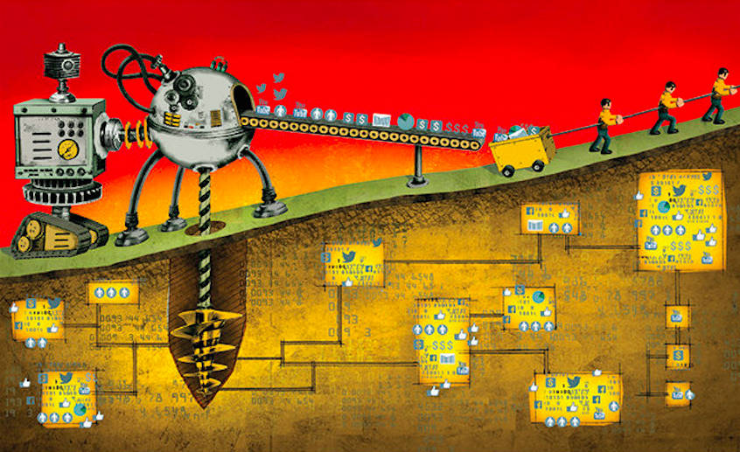


NEED for advanced crypto
Data as a valuable resource
  Why? - analyze and gain insight
    Extract essential information
    Build predictive models
    Better understanding and targeting
  Value often comes from putting together different private data sets
Data use challenges
  Liability - security breaches, rogue employees, subpoenas
  Restricted sharing - policies and regulations protecting private data
  Source of discrimination – unfair algorithms
Privacy preserving computation – promise to obtain utility without sacrificing privacy
  Reduce liability
  Enable new services and analysis
  Better user protection

Slide 6
Overview of primitives

Slide 7



Secure Computation
Secure computation
protocol
X
Y
F(X,Y)
F(X,Y)
Security means: the parties cannot learn
more than what is revealed by the result

Slide 8



Two Party Computation
Real World
Ideal World
Honest Party
Input: X
Simulator
No Input
Adversary
Adversary
≈
Y
F(X, Y)
Trusted Party
F(X, . )

Slide 9
Adversaries
Semi-Honest
Malicious
Follows the steps prescribed by the protocol but tries to extract additional information about the other party’s private input
Example: an adversary that can eavesdrop the communication but cannot modify it
An adversary that can arbitrarily deviate from the steps prescribed by the protocol
Example: an adversary which can impersonate one of the parties

Slide 10
Security
A two party computation protocol between party A and party B is secure computation protocol against semi-honest adversaries if:
  It is secure against a semi-honest adversary controlling party A
    There exists a simulator Sim_{B} that can simulate the protocol interaction with A only given the output
  It is secure against a semi-honest adversary controlling party B
    There exists a simulator Sim_{A} that can simulate the protocol interaction with B only given the output

Slide 11





Multiparty Computation
f( . , . , . , . , . )
C
B
A
f(A, B, C, D, E)
D
E

Slide 12

Security
Ideal World
Real World
F(X₁, … , X₅)
F(X₁, … , X₅)
≈

Slide 13
Zero-Knowledge Proofs
How to prove you know something without saying it out loud?

Slide 14
Statements to prove:
  Bob knows how distinguish Pepsi and Coke
  Bob know a three coloring of a graph
  Bob has a ciphertext that encrypts a value in the range [0,1]
  Bon knows assignments of the wires of a circuit computing F such that z=F(X,Y) is the value assigned to the output wire, when X is the assignment of the first input wires.
Zero-Knowledge
X
Y
Prover
Secret input X called witness
Verifier:
no secret input,
if any input Y, Y is public
F(X,Y)
F(X,Y)

Slide 15
Zero Knowledge Properties
Completeness – if the statement is true, the verifier will accept with probability one
Soundness – if the statement is false, then the probability that the verifier accepts is negligible
Zero-Knowledge – the verifier learns nothing more than the validity of the statement
  Construct a simulator who can impersonate the prover without knowing anything about the witness (or how to prove the statement) providing indistinguishable view for the verifier

Slide 16


Zero Knowledge Proofs
statement
Why ZK proofs?
  Blockchain application – prove properties about encrypted data
  Machine learning – prove input properties, generate proofs for correct model training or evaluation
ZK protocols efficiency properties
  Prover’s efficiency
  Verifier’s efficiency
  Succinctness – proof length
  (Non-)interactiveness
  Trusted setup: common reference string
SNARKS (succinct non-interactive arguments of knowledge) vs others
  Existing constructions require trusted setup
  Hybrid construction – zkSHARKs [RVT18]
witness
ct = Enc(x)
x ∊ [0, 1]
𝛑
sk, x
proof
Prove that you know something without revealing it

Slide 17
Differential privacy [DMNS06]
What does the output reveal about individuals?
The output does not reveal whether an individual was in the input database
Notes:
[DMNS06] Calibrating Noise to Sensitivity in Private Data Analysis, Dwork, McSherry, Nissim, Smith, TCC’06

Slide 18
Data Privacy
Scientific Progress
Collection of Personal Data
Medical Research
Analysis
Outcome
Better Services
Policy
Making
Can we computes and release functions on private data while protecting individual privacy?

Slide 19
Anonymization
Collection of Personal Data
Safe to Use Anonymized Data
Unattainable in Practice
Numerous Attacks on Anonymization Schemes
De-Identify
A trusted curator removes personal identifiable information (PII), e.g. names, emails, SSN,…, to get anonymity and hence privacy

Slide 20
GIC Linkage Attack [Sweeney’00]

Slide 21
GIC Linkage Attack [Sweeney’00]
Health data useful for medical researchers, policy makers, etc.

Slide 22
GIC Linkage Attack [Sweeney’00]

Slide 23
GIC Linkage Attack [Sweeney’00]
Sweeney re-identified the medical records of William Weld (governor of Massachusetts at the time) – according to Cambridge voter list
  6 people with his birthdate
  3 of the above men
  He was the only one with his 5digit zip code
Re-identification
  dob + 5zip -> re-identify 69% of Americans
  dob + 9zip -> re-identify 97% of Americans
Other data
  Health data, clinical trial data, DNA, pharmacy data, text data, registry information

Slide 24
Netflix Data Release [Narayanan, Shmatikov, 08]
Ratings for a subset of movies and users
Usernames replaced with random IDs
Some additional perturbation

Slide 25
Netflix Data Release [Narayanan, Shmatikov, 08]
On average 4 movies uniquely identify a user
Netflix cancelled second round of the competition

Slide 26
Privacy Notions
K-anonymity – each individual should not be distinguishable among a group of k
  Homogeneity attack – correlation with other data
L-Diversity – l distinct values for each sensitive attribute in each equivalence class
  More attacks …

Slide 27
Differential Privacy [Dwork,McSherry,Nissim,Smith ‘06]
Ignore Mariana’s data
Collection of Personal Data
Analysis
Outcome
Mariana’s data
same
Collection of Personal Data
Analysis
Outcome

Slide 28
Differential Privacy [Dwork,McSherry,Nissim,Smith ‘06]
Ignore everybody’s data
Collection of Personal Data
Analysis
Outcome
Mariana’s data
same
Collection of Personal Data
Analysis
Outcome

Slide 29
Differential Privacy [Dwork,McSherry,Nissim,Smith ‘06]
Collection of Personal Data
Analysis
Outcome
Mariana’s data
“close”
Collection of Personal Data
Analysis
Outcome

Slide 30
Differential Privacy
ε-differential privacy definition
A randomized algorithm M : X^{n} ➝ T is ε – differentially private, if for every two neighboring databases X, X’ (which differ on a single entry) and every subset S of the set of all possible outputs T
Pr [ M(X) ∈ S ] ≤ e^{ε} Pr [ M(X’) ∈ S ]

Slide 31
Scenarios for differential privacy
Central Model
Local Model
Q₁
Q₁
A
A(X)
A
A(X’)
Q₂
Q₂
A(x’,B)
A(x,B)
Untrusted Aggregator
Untrusted Aggregator
Q_{n-1}
Q_{n-1}
Q_{n}
Q_{n}
(𝜺,𝛅)-differential privacy
∀ neighboring X,X’, and ∀ sets of output T
Pr_{coins of A}[A(X)∊T] ≦ e^{𝜺} .Pr_{coins of A}[A(X’)∊T] + 𝛅
(𝜺,𝛅)-local differential privacy
∀ neighboring x,x’, ∀ behavior B of other parties, and ∀ sets of output T
Pr_{coins of Qi}[A(x,B)∊T] ≦ e^{𝜺} .Pr_{coins of Qi}[A(x’,B)∊T] + 𝛅
Notes:
[MT07] Mechanism Design via Differential Privacy, McSherry, Talwar, FOCS07
[DJW13] Local Privacy and Statistical Minimax Rates, Duchi, Jordan, Wainwright, FOCS13
[FTS17] Differentially Private Empirical Risk Minimization with Input Perturbation, Fukuchi, Tran, Sakuma, Journal of Machine Learning Research 17
[ACGMMTZ16] Deep Learning with Differential Privacy, Abadi, Chu, Goodfellow, McMahan, Mironov, Talwar, Zhang, CCS16
[WFS15] Privacy for Free: Posterior Sampling and Stochastic Gradient Monte Carlo, Wang, Fienberg, Smola, International Conference on Machine Learning 15
[JDH16] Differentially private variational inference for non-conjugate models, J\u{a}lk\u{l}, Dikmen, Honkela, Conference on Uncertainty in Artificial Intelligence 17
[PFCW16] DP-EM: Differentially Private Expectation Maximization, Park, Foulds, Choudhary, Welling, International Conference on Artificial Intelligence and Statistics 17
[EPK14] RAPPOR: Randomized Aggregatable Privacy-Preserving Ordinal Response, Erlingsson, Pihur, Korolova, CCS’14

Slide 32
Constructions and efficiency

Slide 33
Privacy preserving computation: two scenarios
Few Input Parties
Federated Learning
Equal computational power
Connected parties
Availability
Weak devices
Star communication
Devices may drop out

Slide 34
Few Input parties
Equal computational power
Connected parties
Availability

Slide 35
Two party computation
Yao’s Garbled Circuits

Slide 36
Circuit Evaluation
AND
OR
OR
AND
OR
F
AND
AND

Slide 37
Circuit Evaluation
1
0
0
0
0
1
1
1
AND
OR
OR
AND
0
0
1
1
OR
F
AND
0
1
AND
0

Slide 38

Evaluation
0
1
AND
In1 In2 Out
0 0 0
0 1 0
1 0 0
1 1 1
0

Slide 39




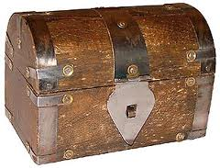


Yao Garbled Evaluation
k00
k01
k10
k11
0/1
0/1
AND
ENC_{k00} ENC_{k10} (k20)
In1 In2 Out
ENC_{k00} ENC_{k11} (k20)
0 0 0
0 1 0
1 0 0
1 1 1
ENC_{k01} ENC_{k10} (k20)
ENC_{k01} ENC_{k11} (k21)
ENC_{k} (m) = m XOR k
0/1
k20
k21

Slide 40
Garbled Evaluation
0
1
AND
In1 In2 Out
0 0 0
0 1 0
1 0 0
1 1 1
0

Slide 41
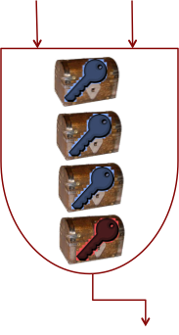
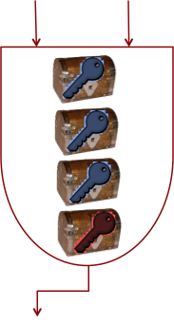
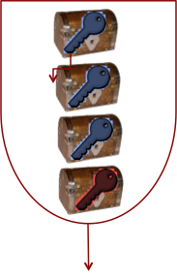
Secure Computation
F (X_{alice},Y_{bob})
0
1

Slide 42
Oblivious Transfer (OT)
Sender
Inputs: m₀, m₁
Receiver
Inputs: b
Output: ⊥
Output: m_{b}

Slide 43
Oblivious Transfer Protocol
G, g, q
The sender published a random value C ∈ G
PK_{b} = g^{k},
PK_{1-b} = C/PK_{b}
CT₀ = (g^{r}, H(PK₀^{r},0)⨁m₀)
CT₁ = (g^{r}, H(PK₁^{r}, 1)⨁m₁)
Receiver: b
Sender: m₀, m₁
(g^{r})^{k} = PK_{b}^{r}
m_{b} = CT_{b}[2] ⨁H(PK_{b}^{r}, b)

Slide 44

General two party computation
[PSSW09]
[SS11]
Compute F(X, Y) without revealing anything more about X and Y
[PSSW09]
[HKSSW10]
[HEKM11]
[ZSB13]
X
Y
[BHKR13]
[GLNP15]
F(X,Y)
Caveats: single vs amortized, different assumptions
Fastest malicious single execution [WRK17]:
LAN=6.6ms/online=1.23ms
WAN=113.5ms/online=76ms
Notes:
[PSSW09] Secure Two-Party Computationis Practical, Pinkas, Schneider, Smart, Williams, Asiacrypt’09
[HKSSW10] TASTY:Tool for Automating Secure Two-party computations, Henecka, Kögl, Sadeghi, Schneider, Wehrenberg, CCS’10
[HEKM11] Faster Secure Two-Party Computation Using Garbled Circuits, Huang, Evans, Katz, Malka, Usenix’11
[ZSB13] PICCO: A General-Purpose Compiler for Private Distributed Computation, Zhang, Steele, Blanton, CCS’13
[BHKR13] Efficient Garbling from a Fixed-Key Blockcipher, Bellare, Hoang, Keelveedhi, Rogaway, S&P’13
[GLNP15] Fast Garbling of Circuits Under Standard Assumptions, Gueron, Lindell, Nof, Pinkas, CCS’15
[SS11] Two-Output Secure Computation with Malicious Adversaries, shelat, Shen, EC’11
[KSS11] Billion-Gate Secure Computation with Malicious Adversaries, Kreuter, shelat, Shen, Usenix’11
[WMK17] Faster two-party computation secure against malicious adversatries in the single-execution setting, Wang, Malozemoff, Katz, EC’17
[RR16] Faster Malicious 2-party Secure Computation with Online/Offline Dual Execution, Rindal, Rosulek,, Usenix’16
[WRK17] Global-Scale Secure Multiparty Computation, Wang, Ranellucci, Katz, CCS’17

Slide 45
Private set intersection (PSI)
Compute intersection without revealing anything more about the input sets.
Patients
Patients
Common Patients
Notes:
[IKNPSSSY17] Private Intersection-Sum Protocol with Applications to Attributing Aggregate Ad Conversions, Ion, Kreuter, Nergiz, Patel, Saxena, Seth, Shanahan, Yung
WAN setting, single threaded

Slide 46
Secure Set Intersection
Compute the intersection
Z = X∩Y = {z₁,…, z_{k}}
H(x₁),…, H(x_{n})
H(y₁),…, H(y_{m})
Not secure since each party can at a later time test whether another element is in the set
X = {x₁,…, x_{n}}
Y = {y₁,…, y_{m}}

Slide 47
Secure Set Intersection
Compute the intersection
Z = X∩Y = {z₁,…, z_{k}}
(H(x_{π(1)})ª,…, H(x_{π(n)}) ª
(H(x_{π’(1)})^{ab},…, H(x_{π’(n)}) ^{ab}
(H(y_{τ(1)}))^{b},…, (H(y_{τ(m)}))^{b}
X = {x₁,…, x_{n}}
Key a
(H(y_{τ’(1)}))^{ba},…, (H(y_{τ’(m)}))^{ba}
Y = {y₁,…, y_{m}}
Key b

Slide 48
Private set intersection (PSI)
Compute intersection without revealing anything more about the input sets.
Patients
Patients
Common Patients
Private Intersection-Sum
Google: aggregate ad attribution [IKNPSSSY17]
= 2²⁰
[KKRT16] Efficient Batched Oblivious PRF with Applications to Private Set Intersection, Kolesnikov, Kumaresan, Rosulek, Trieu, CCS’16
[RR17] Malicious-Secure Private Set Intersection via Dual Execution, Rindal, Rosulek, CCS’17
Notes:
[IKNPSSSY17] Private Intersection-Sum Protocol with Applications to Attributing Aggregate Ad Conversions, Ion, Kreuter, Nergiz, Patel, Saxena, Seth, Shanahan, Yung
WAN setting, single threaded

Slide 49
Homomorphic encryption
How to compute on encrypted data? E.g.,
  evaluate statistics on encrypted data
  evaluate queries on an encrypted database
  train machine learning models on encrypted training data
How to combine ciphertexts?
  Additive homomorphic encryption
    Enc(x) ⊕ Enc(y) = Enc(x+y)
    Example: Paillier encryption
  Multiplicative homomorphic encryption
    Enc(x) ⊗ Enc(y) = Enc(x . y)
    Example: El Gamal
  Fully homomorphic encryption
    Both additive and multiplicative homomorphisms
    Gentry’09

Slide 50
El Gamal encryption
Gen(1^{n}):
  Generate a cyclic group G of order q with generator g
  Choose random x←Z_{p} and set h=g^{x}
  Set PK = (G, q, g, h) and SK = (G, q, g, x)
Enc_{PK}(m): // m∈G
  Choose random r←Z_{p}
  Output c= (g^{r}, h^{r.}m)
Dec_{SK}(c = (c₁,c₂))
  Output m = c₂/c₁^{x}
Correctness:
  c₂/c₁^{x} = h^{r.}m/ (g^{r})^{x} = (g^{x})^{r.}m / g^{xr}
Multiplicative Homomorphism
  Enc(x) = (g^{r}, h^{r.}x)
  Enc(y) = (g^{t}, h^{t.}y)
  Enc(x)⊗ Enc(y) = (g^{r} g^{t}, h^{r.}m h^{t.}y) = (g^{r+t}, h^{r+t.}xy) = Enc(xy)

Slide 51

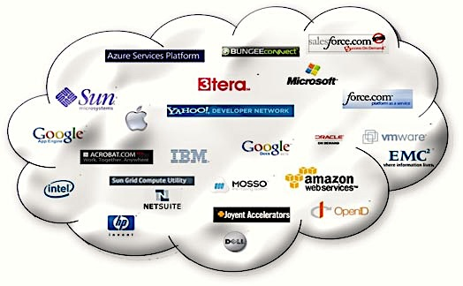

Fully homomorphic encryption
Compute on encrypted data
[HPS19] Homomorphic multiplication for a circuit of depth 20 in 62 ms
[CGHHJLL18]
  iDASH competition task – logistic regression training on 1500 patient records with 18 binary features
  0.4-3.2h per gradient descent iteration
Enc( )
Statistics F
F(Enc( ) )
Compute F without any interaction with the hospital
[HPS19] An Improved RNS Variant of the BFV Homomorphic Encryption Scheme, Halevi, Polyakov, Shoup , CT-RSA’19
[CGHHJLL18] Logistic regression over encrypted data fromfully homomorphic encryption, Chen, Gilad-Bachrach, Han, Huang, Jalali, Laine, Lauter, BMC Medical Genomics’18
Notes:
Mention accuracy

Slide 52
Private Information Retrieval
Homomorphic Encryption – compute on encrypted data
Retrieve data at requested index without revealing the query to the database party
1 | data₁
2 | data₂
3 | data₃
…
n | data_{n}
data_{i}
i
= 2²²
[ACLS18] PIR with Compressed Queries and Amortized Query Processing, Angel, Chen, Laine, Setty, S&P’18

Slide 53
Privacy preserving machine learning
“Out-of-the-box” use of general MPC is not the most efficient approach
Make ML algorithms MPC-friendly
  Floating point computation is expensive in MPC – leverage fixed point arithmetic
  Non-linearity is expensive in MPC – more efficient approximation (e.g., approximate ReLU)
Optimize MPC for ML computation
  Specialized constructions for widely used primitives
    e.g., matrix multiplication – precomputation of matrix multiplication triples [MZ17]
  MPC for approximate functionalities
    e.g., error truncation on shares [MZ17], approximate FHE[CKKS17], hybrid GC+FHE [JVC18]
Trade-offs between accuracy and efficiency
  Regression algorithms good candidates
Sparsity matters
  Sparse BLAS standard interface - MPC equivalent [SGPR18]
skip
Notes:
[MZ17] SecureML: A System for Scalable Privacy-Preserving Machine Learning, Mohassel, Zhang, S&P’17
[CKKS17] Homomorphic Encryption for Arithmetic of Approximate Numbers, Chen, Kim, Kim, Song, Asiacrypt’17
[JVC18] GAZELLE: A Low Latency Framework for Secure Neural Network Inference, Juvekar, Vaikuntanathan, Chandrakasan, USENIX’18
[SGPR18] Make Some ROOM for the Zeros: Data Sparsity in Secure Distributed Machine Learning, Gascon, Schoppmann, Pinkas, Raykova

Slide 54
Privacy Preserving distributed Linear Regression
Patient | Blood Count |  |  |  | Digestive Track |  | ... | Medicine Effectiveness
 | RBC | … | Arrhythmia | … | Inflammation | …
A | 3.9 |  | 0 |  | 0 |  |  | 1
B | 5.0 |  | 0 |  | 1 |  |  | 1.5
C | 2.5 |  | 1 |  | 1 |  |  | 2
D | 4.3 |  | 1 |  | 0 |  |  | 1
. . . | . . . | . . . | . . . | . . . | . . . | . . . | . . . | . . .
Solving system of linear equations with Fixed Point CGD [GSBRDZE17]
- Variant of conjugate gradient descent stable for fixed point arithmetic
Vertically partitioned database:
Party1, Party2, Party3,…
MPC output: linear model
Linear System Computation
Database size: 500 000 records
#attributes/time:
20/15s, 100/4m47s, 500/1h 54min
[GSBRDZE17] Privacy-Preserving Distributed Linear Regression on High-Dimensional Data, Gascon, Schoppmann, Balle, Raykova, Doerner, Zahur, Evans, PETS’17

Slide 55
Secure Neural Networks inference
Neural network (NN) inference without revealing more about the model or the input
Neural network (NN) training without revealing more about the model or the input
Input
NN model
Training Set Partition I
Training Set
Partition II
Classification
result
NN model

Slide 56
Secure Neural Networks inference
Neural network (NN) inference without revealing more about the model or the input
Neural network (NN) training without revealing more about the model or the input
NN model Share I
Training Set Partition II
Input
NN model Share II
Training Set Partition I
Classification
result
NN model
Training Set Partition III
Protocols with 3 or more (non-colluding) parties could improve efficiency
Not much work in the context of ML applications

Slide 57
Secure Neural Networks inference
Compute convolution neural network (CNN) prediction without revealing more about the model or the input
MNIST dataset – 60000 (28x28, 2 color) images of digits
CNN Topology | Runtime (s) | Communication (MB)
3FC layers + square activation | 0.03 | 0.5
1-Conv and 3-FC layers + square activation | 0.03 | 0.5
1-Conv and 3-FC layers + ReLU activation | 0.2 | 8
1-Conv and 3-FC layers + ReLU and MaxPool activation | 0.81 | 70
Input
CNN model
Classification
result
Hybrid solution [JVC18] for secure CNN classification
Techniques: FHE for linear layers (SIMD operations with ciphertext packing), garbled circuits for non-linear layers
CIFAR-10 Dataset (32x32, 3 colors, 10 classes)
7 activation layers (convolution, ReLU, Mean Pooling)
Time: 12.9s
Communication: 1236MB
[JVC18] GAZELLE: A Low Latency Framework for Secure Neural Network Inference, Juvekar, Vaikuntanathan, Chandrakasan, USENIX’18

Slide 58
Secure Neural Networks inference
Customized Neural Network Binarization
Linear scaling – scale the number of channels/neurons in all BNN layers with the same factor
Train NN with scaled parameters
Network Trimming – post-processing that removes the redundant channels/neurons from each hidden layer
  Feature ranking – in terms of contribution to inference accuracy (magnitude of gradient value, Taylor approx.)
  Iterative pruning – removes lowest importance features to maximize ratio of gain of efficiency/e^accuracy loss
Compute binary neural network (BNN) prediction without revealing more about the model or the input
Input
BNN model
Classification
result
[RSCLLK19] XONN:XNOR-based Oblivious Deep Neural Network Inference, Riazi, Samragh, Chen, Laine, Lauter, Koushanfar, 2019

Slide 59
Secure Neural Networks inference
Garbled Circuits + Conditional Oblivious Addition, customized BNNs
Evaluation: MNIST dataset – 60000 (28x28) images of digits
BNN Architecture | Runtime (s) | Communication (MB) | Accuracy
BM1: 3FC layers + binary activation | 0.13 | 4.27 | 97.6%
BM2: 1-Conv and 3-FC layers + binary activation | 0.16 | 38.28 | 98.64%
BM3: 2-Conv, 2-MP and 3-FC layers + binary activation | 0.15 | 32.13 | 99%
[RSCLLK19] XONN:XNOR-based Oblivious Deep Neural Network Inference, Riazi, Samragh, Chen, Laine, Lauter, Koushanfar, Usenix Security 2019

Slide 60
Secure Neural Networks inference
Garbled Circuits + Conditional Oblivious Addition, customized BNNs
Evaluation: CIFAR-10 dataset – 60 000 (32x32) color images in 10 different classes
BNN Architecture | Runtime (s) | Communication (MB) | Accuracy
BC2: 9CONV + 3MP+1FC + BN +Softmax | 10.35 | 3.4 | 82%
BC3: BC2 with larger windows and input size | 35.77 | 11.89 | 86%
BC4: 11CONV + 3MP+1FC+ BN +Softmax (dim BC3) | 123.94 | 41.37 | 88%
[RSCLLK19] XONN:XNOR-based Oblivious Deep Neural Network Inference, Riazi, Samragh, Chen, Laine, Lauter, Koushanfar, Usenix Security 2019

Slide 61
Secure Neural Networks Training
Compute Neural network (NN) training without revealing more about the model or the input
 | Online | Offline
RELU | 14951.2s | 10332.3s
Square | 16783.9s | 4260.3s
Training Set Partition I
Training Set
Partition II
NN model
MNIST dataset – 60000 (28x28) images of digits
LAN setting (no measurement for WAN)
2 hidden layers NN with 128 neurons
SGD with batch size 128 and convergence at 15 epochs
[MZ17] SecureML: A System for Scalable Privacy-Preserving Machine Learning, Mohassel, Zhang, 2017

Slide 62
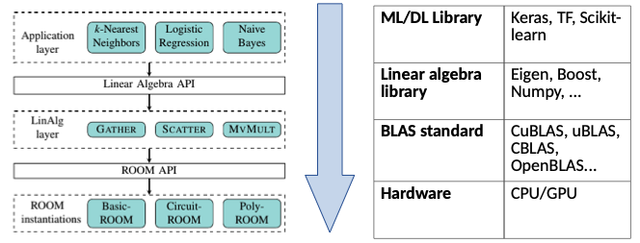
Leveraging sparsity
[SGPR18] Make Some ROOM for the Zeros: Data Sparsity in Secure Distributed Machine Learning, Gascon, Schoppmann, Pinkas, Raykova, CCS 2019

Slide 63
Leveraging sparsity
Logistic Regression Training on
Sparse Data [SGPR18]
Dataset | Documents | Classes | Features Total | SecureML [MZ17] | Ours [SGPR18]
Movies | 34341 | 2 | 95626 | 6h23m27.85s | 2h43m51.5s
Newsgroups | 9051 | 20 | 101631 | 1h41m4.74s | 41m45.73s
Language Ngrams | 783 | 11 | 9915 | 1h2m10.0s | 5m30.1s
[SGPR18] Make Some ROOM for the Zeros: Data Sparsity in Secure Distributed Machine Learning, Gascon, Schoppmann, Pinkas, Raykova, CCS 2019

Slide 64
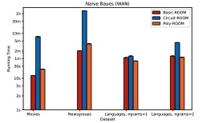
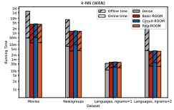
Leveraging sparsity
[SGPR18] Make Some ROOM for the Zeros: Data Sparsity in Secure Distributed Machine Learning, Gascon, Schoppmann, Pinkas, Raykova, CCS 2019

Slide 65
Federated learning
Weak devices
Star communication
Devices may drop out

Slide 66
Secure aggregation
Compute sums of model parameters without revealing individual inputs
Google’s interactive protocol for Secure Aggregation [BIKMMPRSS17]
Aggregate parameters for global model
Vector size 100K
500 Clients
Learn local model
[BIKMMPRSS17] Practical Secure Aggregation for Federated Learning on User-Held Data, Bonawitz, Ivanov, Kreuter, Marcedone, McMahan, Patel, Ramage, Segal, Seth, CCS’17

Slide 67

Prio: aggregate statistics
Distributed Aggregation with Several Servers (At Least One Honest Server)
Training of D-dimensional least squares regression [CB17]
Deployment in Firefox
MPC to verify proof and compute
aggregate statistics
Regression dimension | Throughput per second |  | Rate Slowdown
 | No privacy and robustness | Prio: privacy and robustness
2 | 14688 | 2608 | 5.6x
4 | 15426 | 2165 | 7.1x
6 | 14773 | 2048 | 7.2x
8 | 15975 | 1606 | 9.5x
10 | 15589 | 1430 | 10.9x
12 | 15189 | 1312 | 11.6x
Each device: encode input and compute validity proof, and send part to each server
5 servers
[CB18] Prio: Private, Robust, and Scalable Computation of Aggregate Statistics, Corrigan-Gibbs, Boneh, NSDI’18

Slide 68
Differential privacy [DMNS06]
What does the output reveal about individuals?
The output does not reveal whether an individual was in the input database
Notes:
[DMNS06] Calibrating Noise to Sensitivity in Private Data Analysis, Dwork, McSherry, Nissim, Smith, TCC’06

Slide 69

Scenarios for differential privacy
Central Model
Local Model
Q₁
Q₁
A
A(X)
A
A(X’)
Q₂
Q₂
A(x’,B)
A(x,B)
Untrusted Aggregator
Untrusted Aggregator
Q_{n-1}
Q_{n-1}
General methods:
Global sensitivity method: Laplace, Gaussian mechanisms [DMNS06]
Exponential mechanism [MT07]
Specialized methods
DP Empirical Risk Minimization [DJW13, FTS17]
DP Stochastic Gradient Descent (SGD) and Neural Nets [ACGMMTZ16]
DP Bayesian Inference [WFS15, JDH16, PFCW16]
Google RAPPOR [EPK14]
Apple Privacy Preserving Statistics in iOS
Challenge: utility/privacy trade-offs
Q_{n}
Q_{n}
(𝜺,𝛅)-differential privacy
∀ neighboring X,X’, and ∀ sets of output T
Pr_{coins of A}[A(X)∊T] ≦ e^{𝜺} .Pr_{coins of A}[A(X’)∊T] + 𝛅
(𝜺,𝛅)-local differential privacy
∀ neighboring x,x’, ∀ behavior B of other parties, and ∀ sets of output T
Pr_{coins of Qi}[A(x,B)∊T] ≦ e^{𝜺} .Pr_{coins of Qi}[A(x’,B)∊T] + 𝛅
Notes:
[MT07] Mechanism Design via Differential Privacy, McSherry, Talwar, FOCS07
[DJW13] Local Privacy and Statistical Minimax Rates, Duchi, Jordan, Wainwright, FOCS13
[FTS17] Differentially Private Empirical Risk Minimization with Input Perturbation, Fukuchi, Tran, Sakuma, Journal of Machine Learning Research 17
[ACGMMTZ16] Deep Learning with Differential Privacy, Abadi, Chu, Goodfellow, McMahan, Mironov, Talwar, Zhang, CCS16
[WFS15] Privacy for Free: Posterior Sampling and Stochastic Gradient Monte Carlo, Wang, Fienberg, Smola, International Conference on Machine Learning 15
[JDH16] Differentially private variational inference for non-conjugate models, J\u{a}lk\u{l}, Dikmen, Honkela, Conference on Uncertainty in Artificial Intelligence 17
[PFCW16] DP-EM: Differentially Private Expectation Maximization, Park, Foulds, Choudhary, Welling, International Conference on Artificial Intelligence and Statistics 17
[EPK14] RAPPOR: Randomized Aggregatable Privacy-Preserving Ordinal Response, Erlingsson, Pihur, Korolova, CCS’14

Slide 70
Randomized Response
Collect aggregate statistics for answer of 0/1 question
Respond as follows
  1. Flip a coin
  2. If the output is tails, answer truthfully
  3. If the output is heads, flip another coin and answer according to its output.
The above algorithm is (ln 3)-differentially private
  Neighboring databases {0}, {1}
  Pr[ Output=1 | x =1 ] / Pr[ Output=1 | x =0 ] = 3

Slide 71
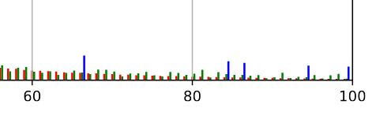
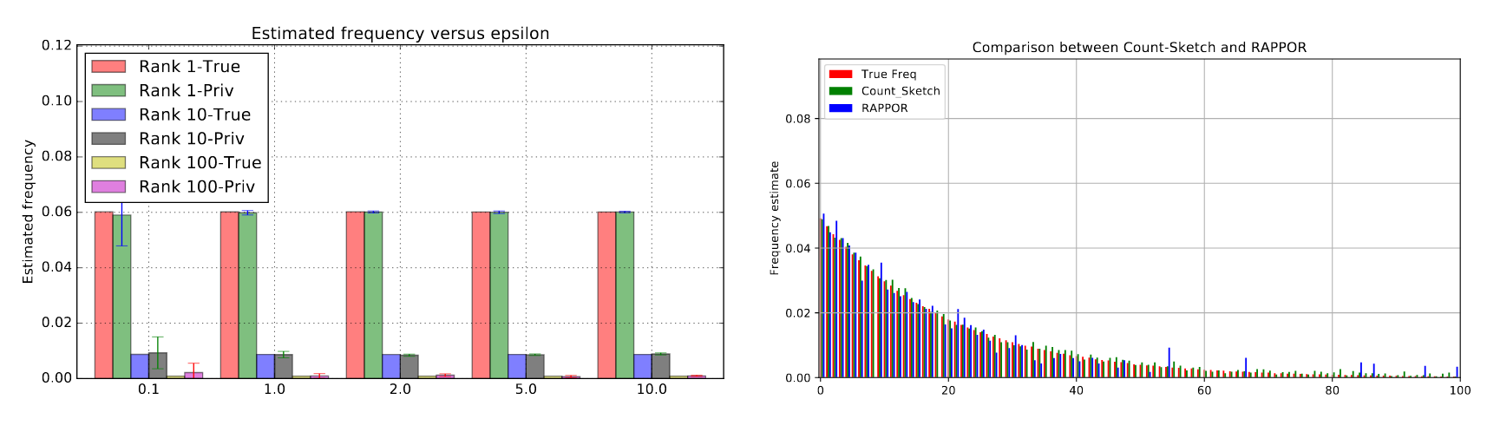
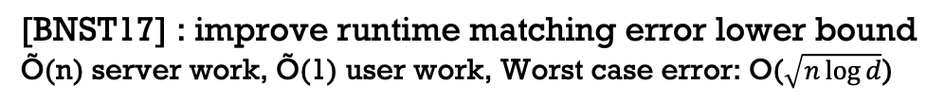
Local DP: Heavy hitters
[BNST17] : improve runtime matching error lower bound
Õ(n) server work, Õ(1) user work, Worst case error: O($\sqrt{n\log{d}}$)
𝜺 = ln(3)
10 million samples with 25991 unique words
Practical Locally Private Heavy Hitters, Bassily, Nissim, Stemmer, Thakurta, NeurIPS 2017
Notes:
Practical Locally Private Heavy Hitters, Bassily, Nissim, Stemmer, Thakurta, NIPS 2017

Slide 72
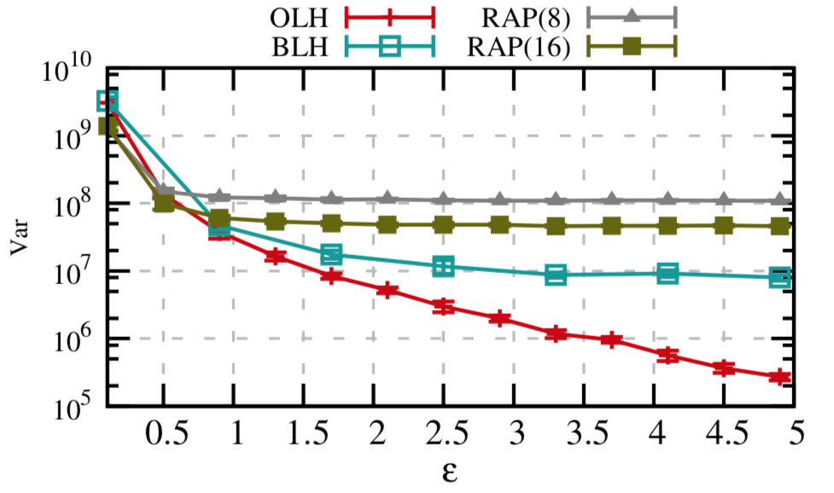
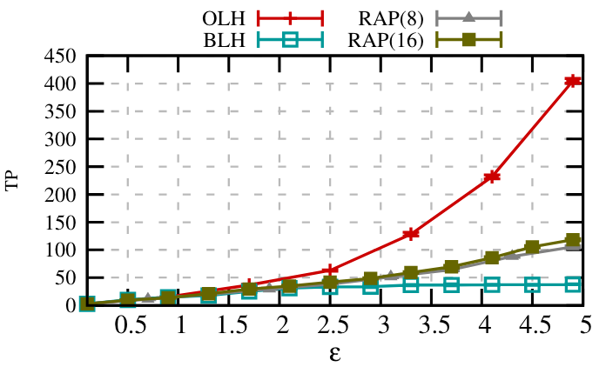
Local DP: Frequency estimation
[WBJL17] : LDP Framework
Parameter optimization and better utility
New Protocols: Optimal Local Hashing (OLH), Binary Local Hashing (BLH)
Average Squared Error
True Positives
Locally Differentially Private Protocols for Frequency Estimation, Wang, Blocki, Li, Jha, USENIX’17

Slide 73
Amplification: DP+MPC
Trusted
Q₁
Q₁
A(X)
Q₂
Q₂
Untrusted Curator
Shuffle
Untrusted Curator
Q_{n-1}
Q_{n-1}
[CSUZZ18] Distributed Differential Privacy via Shuffling, Cheu, Smith, Ullman, Zeber, Zhilyaev
[EFMRTT18] Amplification by shuffling: From local to central differential privacy by anonymity, Erlingsson, Feldman, Mironov, Raghunathan, Talwar, Thakurt
[BEMMPLRKTS18] PROCHLO: Strong Privacy for Analytics in the Crowd, Bittau, Erlingsson, Maniatis, Mironov, Raghunathan, Rudominer, Kode, Tinnes, Seefeld, SOSP’17
Q_{n}
Q_{n}
Trusted to protect other users’ data
Not adding noise can compromise the privacy of others

Slide 74

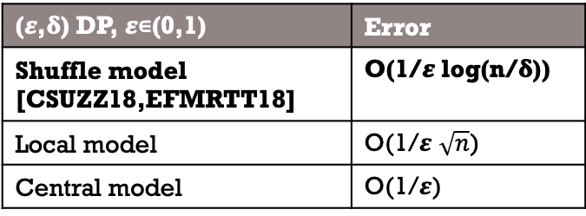
Amplification: DP+MPC
Reduces 𝛆 to 𝛆/$\sqrt{n}$
Q₁
Q₁
A(X)
Q₂
Q₂
Untrusted Curator
Shuffle
Untrusted Curator
Q_{n-1}
Q_{n-1}
[CSUZZ18] Distributed Differential Privacy via Shuffling, Cheu, Smith, Ullman, Zeber, Zhilyaev
[EFMRTT18] Amplification by shuffling: From local to central differential privacy by anonymity, Erlingsson, Feldman, Mironov, Raghunathan, Talwar, Thakurt
[BEMMPLRKTS18] PROCHLO: Strong Privacy for Analytics in the Crowd, Bittau, Erlingsson, Maniatis, Mironov, Raghunathan, Rudominer, Kode, Tinnes, Seefeld, SOSP’17
Q_{n}
Q_{n}
Prochlo
(Google [BEMMRLRKTS18])
Implements shuffle using SGX
Evaluation: recovering unique words
  16-120x more recovered words than RAPPOR on data sets 10K-10M
  Runtime: 2h for 10M
Aggregation
(𝜺,𝛅) DP, 𝜺∊(0,1) | Error
Shuffle model [CSUZZ18,EFMRTT18] | O(1/𝜺 log(n/𝛅))
Local model | O(1/𝜺 $\sqrt{n}$)
Central model | O(1/𝜺)

Slide 75
Privacy blanket of the shuffle Model
Trusted
Q₁
Q₁
Q₂
Q₂
Untrusted Curator
Shuffle
Untrusted Curator
Q_{n-1}
Q_{n-1}
[BBGN’19] The Privacy Blanket of the Shuffle Model, B. Balle, J. Bell, A. Gascon, K. Nissim, 2019
Q_{n}
Q_{n}
Trusted to protect other users’ data
Not adding noise can compromise the privacy of others
Matching Lower and Upper Bound for Single Message Shuffle Model Protocols for Private Summation of Real Numbers
  Error 𝛀(n^{1/6})
New Privacy Amplification Result for Shuffled Mechanisms
  Extends the amplification to 𝛆 = O(log n)

Slide 76
Secure aggregation vs shuffle
Central DP Utility
Q₁
Q₁
Q₂
Q₂
Secure Aggregation
Shuffle
Untrusted Curator
Untrusted Curator
Q_{n-1}
Q_{n-1}
[RSY18] Turning HATE Into LOVE: Homomorphic Ad Hoc Threshold Encryption for Scalable MPC, Reyzin, Smith, Yakoubov
[IKOS06] Cryptography from Anonymity, Yuval Ishai, Eyal Kushilevitz, Rafail Ostrovsky, Amit Sahai
Q_{n}
Q_{n}
“Turning HATE into LOVE”
[RSY18]
Large-scale One-server Vanishing-participants Efficient MPC from Homomorphic Adhoc Threshold Encryption
Lower bound 3 message flows with setup (PKI)
DP not considered
Non-interactive Private Statistics
[IKOS06]
Assumption anonymous channels
Each party shares its input and everyone sends their shares to the server using the anonymous channels

Slide 77
CPSGD
Communication Efficient and Differentially Private SGD
Distributed SGD gradient updates
Distributed Noise Addition + Secure Aggregation
Quantization for better efficiency
Binomial noise instead of Gaussian – better utility when composed with quantization
cpSGD: Communication-efficient and differentially-private distributed SGD, Agarwal, Suresh, Yu, Kumar, Mcmahan, NeurIPS, 2018

Slide 78
Zero-Knowledge Proofs
How to prove you know something without saying it out loud?

Slide 79

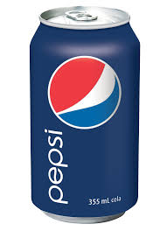
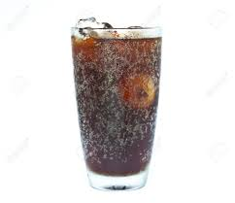
Zero Knowledge Proofs
Coke
Pr[cheating] = ½
Pepsi
Pr[cheating] = ¼
Pr[cheating] = 1/2^{n}

Slide 80
Quadratic Residues
Let n be a composite number that determines the group Z*_{n}
x is a quadratic residue is there exists a value s such that x = s² mod n
The quadratic residues form a group, i.e., if x and y are quadratic residues, so is xy
It is believes that it is hard to tell whether x mod n is quadratic residue without knowing the factorization of n

Slide 81
ZK for Quadratic Residues
x is a quadratic residue mod n
Witness w such that x = w² mod n
y = u² mod n
b
z
Choose a random u ∈ Z*_{n}
Choose a random bit b
If b=0, set z = u.
If b=1, set z = wu.
If b=0, check z² = y mod n.
If b=1, check z² = xy mod n.
Repeat T times

Slide 82
ZK for Quadratic Residues
Completeness: if Alice knows w, she can always answer correctly
Soundness: if x is not quadratic residues, the Alice cannot compute answers that verify both in the case of b=0 and b=1
  If Alice could compute both z₀ = u and z₁ = uw, then z₀² and z₁² are quadratic residues
  Since the quadratic residues form a group, then z₁²(z₀²)⁻¹is quadratic residue
  However, z₁²(z₀²)⁻¹= x, which is a contradiction
Hence, if Alice is cheating, she will be caught with probability ½ in a single repetition and with probability 1-1/2^{t} in t repetitions

Slide 83
Zero Knowledge Proofs
statement
Why ZK proofs?
  Blockchain application – prove properties about encrypted data
  Machine learning – prove input properties, generate proofs for correct model training or evaluation
ZK protocols efficiency properties
  Prover’s efficiency
  Verifier’s efficiency
  Succinctness – proof length
  (Non-)interactiveness
  Trusted setup: common reference string
SNARKS (succinct non-interactive arguments of knowledge) vs others
  Existing constructions require trusted setup
  Hybrid construction – zkSHARKs [RVT18]
witness
ct = Enc(x)
x ∊ [0, 1]
𝛑
sk, x
proof
Prove that you know something without revealing it

Slide 84
ZK SNARKS
Most existing ZK SNARK constructions leverage QAPs (quadratic arithmetic programs) [GGPR13,PGHR13]
  Pinocchio[PGHR13], Geppetto[CFHKKNPZ14]
  libsnark [BCTV14,CTV15]
  Jsnark [KPS18]
  Buffet [WSRBW15]
Distributed Zero Knowledge [WZCPS18] – distribute the proof generation on a cluster
  Prover time: 10𝜇s per gate
  Verifier’s time: 2ms + 0.5𝜇s.(#input group elements)
[GGPR13] Quadratic Span Programs and Succinct NIZKs without PCPs, Gennaro, Gentry, Parno, Raykova, EC13
[PGHR] Pinocchio: Nearly Practical Verifiable Computation, Parno, Gentry, Howell, Raykova, S&P13
[CFHKKNPZ14] Geppetto: Versatile Verifiable Computation, Costello, Fournet, Howell, Kohlweiss, Kreuter, Naehrig, Parno, Zahur, S&P15
[BCTV14] Scalable Zero Knowledge via Cycles of Elliptic Curves, Ben-Sasson, Chiesa, Tromer, Virza, CRYPTO14
[CTV15] Cluster Computingin Zero Knowledge, Chiesa, Tromer, Virza, EC15
[KPS18] xJsnark: A Framework for Efficient Verifiable Computation, Koshba, Papamanthou, Shi, S&P18
[WSRBW15] Efficient RAM and control flow in verifiable outsourced computation, Wahby, Setty, Ren, Blumberg, Walfish, NDSS15
[WZCPS18] DIZK: A Distributed Zero Knowledge Proof System, Wu, Zheng, Chiesa, Popa, Stoica, USENIX18
Application | Prover`s time
Matrix multiplication (700x700) | 74s
Covariance matrix (20K points in 500 dim) | 80s
Linear regression (20K points in 500 dim) | 95s

Slide 85
ZK with Trusted SETUP Continued
Libra (C – circuit size, d – circuit depth):
  Linear Prover: O(C); Proof size and verification: O(d logC)
  Interactive protocol based on GKR (Proof for Muggles)
SHA-256 Merkle Tree Knowledge of leaf assignment corresponding to the root
Libra: Succinct Zero-Knowledge Proofs with Optimal ProverComputation, Xie, Zhang, Zhang, Papamanthou, Song, IEEE S&P 2020
Prover time
Verifier time
Proof size
Image Scaling: high to low resolution, convolution with sliding window

Slide 86
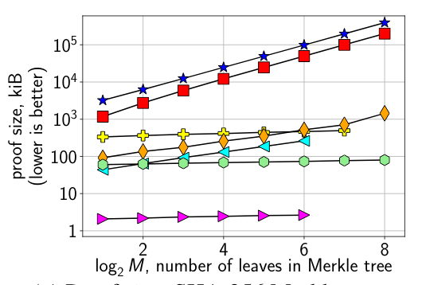
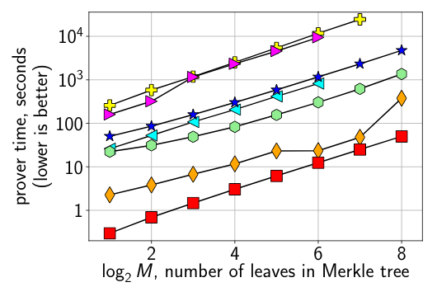
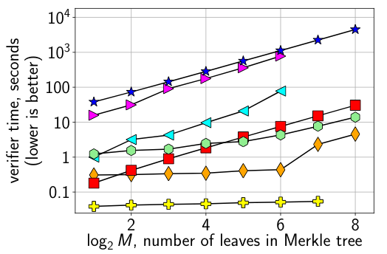
ZK without trusted setup
Efficiency:
  Proof: [O(log n), O(n)]
  Verifier’s work: [O(log n), O(n)]
  Prover’s work: Õ(n)
Many approaches based on different techniques
  Discrete Log Based: BCCGP[BCCGP16], Bullet Proofs [BBBPWM18]
  MPC Based: ZKBoo++ [CDGORRSZ17], Ligero [AHIV17]
  IOP Based: Hyrax[WTsTW18], ZK-STARKs [BBHR18], Aurora [BCRSVW18]
[BCCGR16] Efficient zero-knowledge arguments for arithmetic circuits in the discrete log setting, Bootle, Cerulli, Chaidos, Groth, Petit, EC16
[BBBPWM18] Bulletproofs: Efficient range proofs for confidential transactions, Bunz, JBootle, Boneh, Poelstra, Wuille, Maxwell, S&P18
[CDGORRSZ17] Post-quantum zero-knowledge and signatures from symmetric-key primitives, Chase, Derler, Goldfeder, Orlandi, Ramacher, Rechberger, Slamanig, Zaverucha, CCS17
[AHIV17] Ligero: Lightweight sublinear arguments without a trusted setup, Ames, Hazay, Ishai, Venkitasubramaniam, CCS17
[WTsTW18] Doubly-efficient zkSNARKs without trusted setup, Wahby, Tzialla, shelat, Thaler, Walfish, S&P18
[BBHR18] Scalable, transparent, and post-quantum secure computational integrity, Ben-Sasson, Bentov, Horesh, Riabzev, ‘18
[BCRSVW18] Aurora: Transparent Succinct Arguments for R1CS , Ben-Sasson, Chiesa, Riabzev, Spooner, Virza, Ward, ‘18
Proof size
Prover time
Verifier Time
[WTsTW18] SHA-256 Merkle Tree
Knowledge of leaf assignment corresponding to the root
Notes:
https://eprint.iacr.org/2017/1132.pdf

Slide 87
ZK STARKs
Interactive Oracle Proofs
Quasilinear prover, Polylogarithmic verifier
Scalable, transparent, and post-quantum secure computational integrity, Ben-Sasson, Bentov, Horesh, Riabzev , Crypto 2019
Number of Multiplication Gates
DNA Profile Matching

Slide 88
Verifiable auctions for ad Exchanges
Enable participants to verify the correctness of the auction while maintaining low-latency and high-frequency
Proof for comparison and ordering of the committed auction bids (proof for integer comparison)
Privacy of the bids with respect to the auditor
Verifiable auctions for ad Exchanges, Angel, Walfish, SIGCOMM’13

Slide 89
Verifiable auctions for ad Exchanges
Ad Exchange Timeout: 120ms
Verifiable auctions for ad Exchanges, Angel, Walfish, SIGCOMM’13
20 bidders

Slide 90
How to use advanced crypto?
Not “out-of-the-box” use
  Hiding complexity for usability could sacrifice performance
  Setting parameters requires crypto expertise
  Implementations code quality: definitely not production level
  Comparison across frameworks is non-trivial
Standardization efforts
  HE - http://homomorphicencryption.org/
  ZK - https://zkproof.org/
Sources
  MPC - https://github.com/rdragos/awesome, http://www.multipartycomputation.com
  DP -https://privacytools.seas.harvard.edu/files/privacytools/files/pedagogical-document-dp_new.pdf
  https://github.com/tensorflow/privacy
  ZK - https://zkp.science/
“Time to Put These Tools to Use” Shai Halevi
Thank You!
Questions?

