Slide 1
Resource-efficient Cryptography for Ubiquitous Computing
Elif Bilge Kavun
Summer School on Real-world Crypto and Privacy
20.06.2019, Šibenik

Slide 2
Outline
Why do we need it?
Initial proposals
Proposals addressing certain metrics
Side-channel resistance?

Slide 3
Ubiquitous Computing Era

Slide 4
Ubiquitous Computing Era

Slide 5
Ubiquitous Computing Era

Slide 6
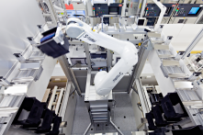
Ubiquitous Computing Era
Embedded devices everywhere!
RFID tags
Smart cards
…
Automation components
Asset tracking systems
Electronic passports
Payment and toll-collection cards

Slide 7
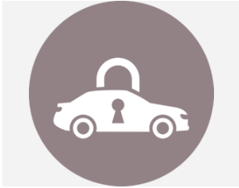
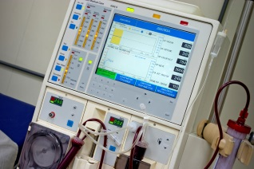
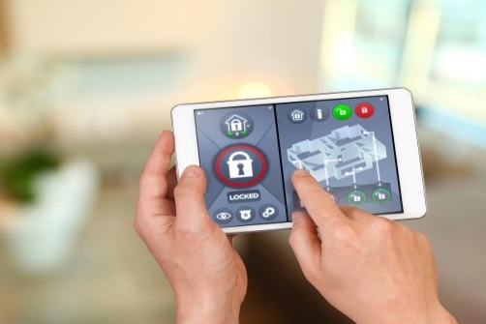
Ubiquitous Computing Era
Security Concerns
Access control
Security
Privacy protection
…
Car key systems
Medical & sensor systems
Smart home
Notes:
More information:
You can crop a picture (trim slices from the side, top or bottom) by selecting on the slide the picture that you want to crop, going to the “format” menu, selecting “picture…” and in the “picture” dialog box clicking the “picture” button. This opens the crop options. The preview button allows you to see whether the crop achieves the effect you wanted. (If you have an old version of PowerPoint these controls may be located differently - refer to the PowerPoint Help menu.)
Before importing a picture into your presentation save it in a suitable format (eg jpeg) at a resolution of 72 dots per inch if possible. This resolution keeps the size of the picture file small but still displays fine on screen – particularly important if you’re using several pictures, because half a dozen taken on a five megapixel digital camera and imported at full resolution could mean that your presentation is over 20 megabytes in size. This means it will take up unnecessary disk space, will be slow to open and run on many less powerful computers – and will be too big to e-mail.

Slide 8
Ubiquitous Computing Era
Good security architectures needed
to resist these attacks!

Slide 9
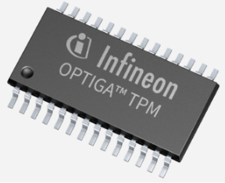
Need for Security: Same level?
Embedded devices are resource-constrained!
Circuit size, ROM/RAM sizes
Power
Energy
Battery-driven devices
Processing speed: Throughput, delay
Large data transmissions
Real-time control processing

Slide 10
Need for Security: Same level?
Conventional cryptography
Servers
Desktops
Tablets
Smartphones

Slide 11
Need for Security: Same level?
Tailored cryptography for
Embedded systems
RFIDs
Sensor networks

Slide 12
Need for “Tailored” Cryptography
Lightweight cryptography!

Slide 13
Need for “Tailored” Cryptography
Resource-efficient cryptography!

Slide 14
What is resource-efficient cryptography?
Reduces computational efforts to provide security
Less expensive than traditional crypto
Not weak, but “sufficient„ security
Reduced level – key size generally below 128 bits

Slide 15
What is resource-efficient cryptography?
Many proposals/implementations so far
Public-key cryptography: ECC, NTRU, …
Stream ciphers: Grain, Trivium, …
Hash functions: Photon, Quark, …
Block ciphers
Core for symmetric crypto, stream ciphers, MAC, etc

Slide 16
Resource-efficient Block Ciphers
Solutions both from industry and academia
Industry
In case of propriatery solutions, no public evaluation
Generally efficient, but non-standard
Lessons learned: MIFARE, Keeloq (stream cipher), etc attacks
Academia
Good solutions, but sometimes missing industry demands

Slide 17
Resource-efficient Block Ciphers
AES: Standard cipher – but, lightweight?
Actually not too bad for software implementations
But expensive for hardware
Serial implementations get close

Slide 18
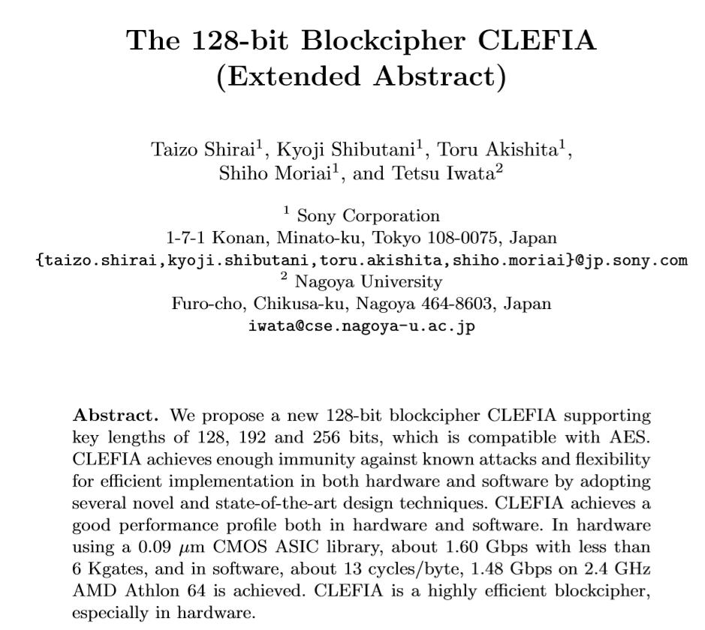
Resource-efficient Block Ciphers

Slide 19
CLEFIA
By SONY
128-bit key minimum
Feistel network
Balancing security, speed, cost
Several Sboxes
ISO standard
Notes:
More information:
You can crop a picture (trim slices from the side, top or bottom) by selecting on the slide the picture that you want to crop, going to the “format” menu, selecting “picture…” and in the “picture” dialog box clicking the “picture” button. This opens the crop options. The preview button allows you to see whether the crop achieves the effect you wanted. (If you have an old version of PowerPoint these controls may be located differently - refer to the PowerPoint Help menu.)
Before importing a picture into your presentation save it in a suitable format (eg jpeg) at a resolution of 72 dots per inch if possible. This resolution keeps the size of the picture file small but still displays fine on screen – particularly important if you’re using several pictures, because half a dozen taken on a five megapixel digital camera and imported at full resolution could mean that your presentation is over 20 megabytes in size. This means it will take up unnecessary disk space, will be slow to open and run on many less powerful computers – and will be too big to e-mail.

Slide 20
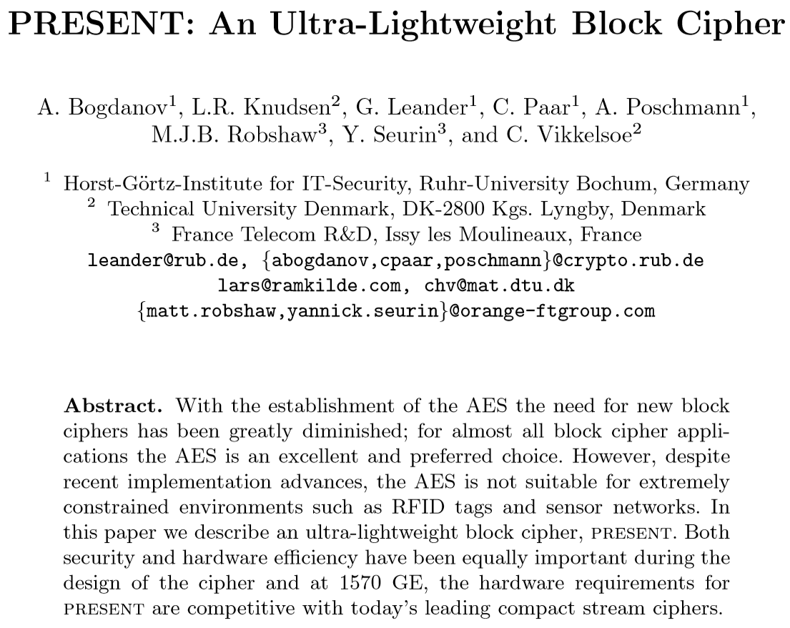
Resource-efficient Block Ciphers

Slide 21
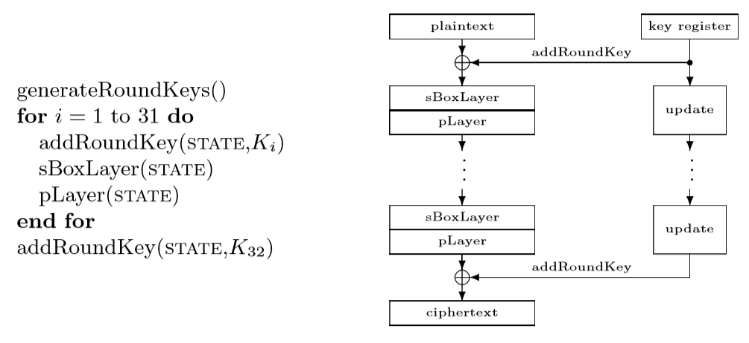
PRESENT
Targeting hardware
Simple but strong design
Well-studied substitution-permutation network (SPN)
Low-area (permutation just wiring in hw!)
ISO Standard

Slide 22
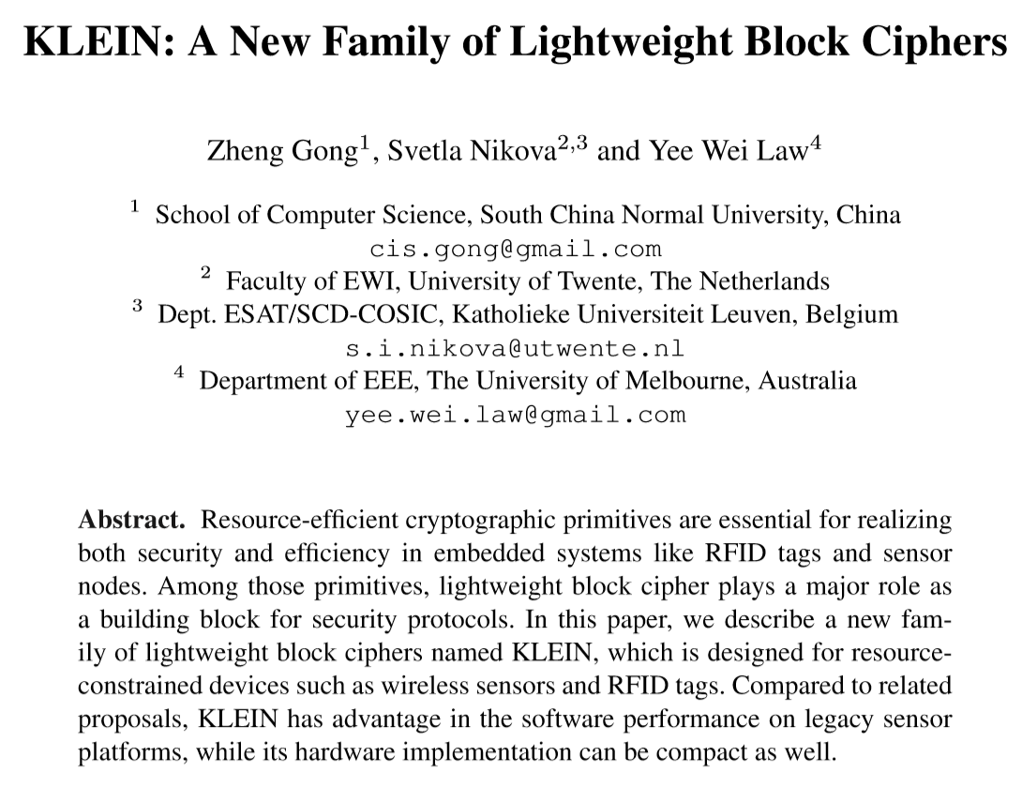
Resource-efficient Block Ciphers

Slide 23
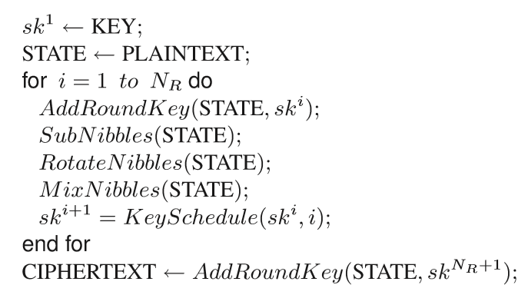
KLEIN
AES-like
Works on nibbles
Involution Sbox

Slide 24
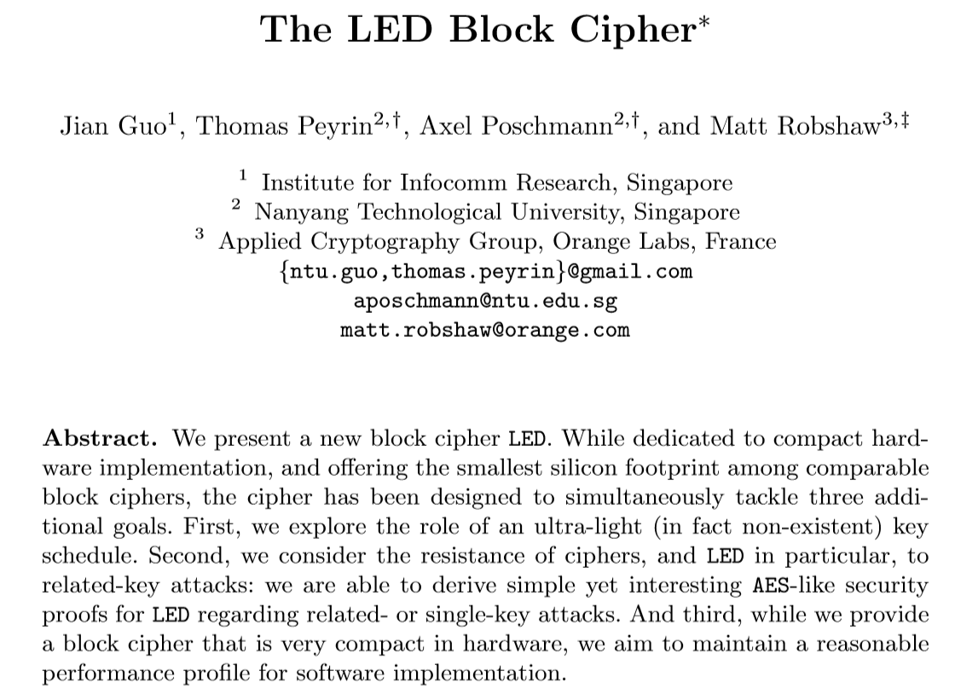
Resource-efficient Block Ciphers

Slide 25
LED
AES-like
Uses PRESENT Sbox
Consists of steps (number based on key size)
Each step 4 rounds

Slide 26
Proposals vs Metrics
Initial proposals mostly address area
There are other important metrics
Security
Number of rounds
Key/data size
Speed/Latency
Area/Power
Implementation
(serial, round-based, unrolled)
Notes:
More information:
You can crop a picture (trim slices from the side, top or bottom) by selecting on the slide the picture that you want to crop, going to the “format” menu, selecting “picture…” and in the “picture” dialog box clicking the “picture” button. This opens the crop options. The preview button allows you to see whether the crop achieves the effect you wanted. (If you have an old version of PowerPoint these controls may be located differently - refer to the PowerPoint Help menu.)
Before importing a picture into your presentation save it in a suitable format (eg jpeg) at a resolution of 72 dots per inch if possible. This resolution keeps the size of the picture file small but still displays fine on screen – particularly important if you’re using several pictures, because half a dozen taken on a five megapixel digital camera and imported at full resolution could mean that your presentation is over 20 megabytes in size. This means it will take up unnecessary disk space, will be slow to open and run on many less powerful computers – and will be too big to e-mail.

Slide 27
 | Hardware | Software
Area/ Code size |  | ?
Latency/ Execution time | ? | ?
mCrypton
LBlock
HIGHT
ITUBee
KLEIN
KLEIN
KATAN
CLEFIA
TWINE
Piccolo
KTANTAN
LED
SPECK
PRESENT
SIMON
SEA
LBlock
TWINE
KLEIN
SPECK

Slide 28
 | Hardware | Software
Area/ Code size |  | ?
Latency/ Execution time | ? | ?
mCrypton
LBlock
HIGHT
ITUBee
KLEIN
KLEIN
KATAN
CLEFIA
TWINE
Piccolo
KTANTAN
LED
SPECK
PRESENT
SIMON
SEA
PRINCE
LBlock
TWINE
KLEIN
SPECK

Slide 29
 | Hardware | Software
Area/ Code size |  | ?
Latency/ Execution time | ? | ?
mCrypton
LBlock
HIGHT
ITUBee
KLEIN
KLEIN
KATAN
CLEFIA
TWINE
Piccolo
KTANTAN
LED
SPECK
PRESENT
SIMON
SEA
PRINCE
PRIDE
LBlock
TWINE
KLEIN
SPECK

Slide 30
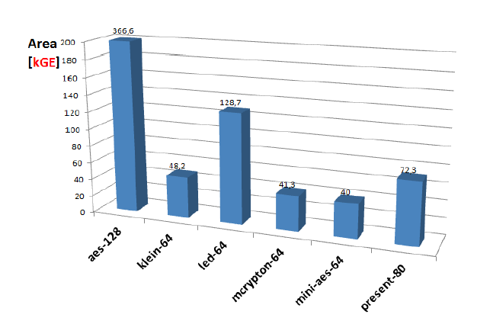
PRINCE: Towards Low-latency
Latency: Time to encrypt one block of data
single clock cycle: Unrolled design fashion
Moderate hardware costs
Encryption and decryption with low overhead
Can we do better?
Graphics credit: Gregor Leander

Slide 31
PRINCE: Towards Low-latency
Latency: Time to encrypt one block of data
single clock cycle: Unrolled design fashion
Moderate hardware costs
Encryption and decryption with low overhead
Can we do better?
Yes, we can!
Graphics credit: Gregor Leander

Slide 32
PRINCE: Key Figures
All rounds are unrolled
Cipher can be thought as one big round
Try to keep the cost of one round as low as possible
All rounds same, decreases cost
Minimum overhead for encryption and decryption
64-bit block, 128-bit key
Core cipher with 64-bit key
64-bit whitening keys
12 rounds

Slide 33
PRINCE: Key Figures
64-bit block, 128-bit key
Core cipher with 64-bit key
64-bit whitening keys
12 rounds
All rounds are unrolled
Cipher can be thought as one big round
Try to keep the cost of one round as low as possible
All rounds same, decreases cost
Minimum overhead for encryption and decryption
64-bit block, 128-bit key
Core cipher with 64-bit key
64-bit whitening keys
12 rounds

Slide 34
PRINCE: Core Cipher
Middle part M’ is an involution linear layer
M and M⁻¹ are derived from M via ShiftRows operations
S: 16 parallel applications of a 4-bit Sbox

Slide 35
PRINCE: Round-based
11 cycles instead of 12!

Slide 36
PRINCE: Sbox
Optimize # of gate equivalents (GE) used by Sbox
This is the main area saving
But not necessarily same for serial implementations!

Slide 37
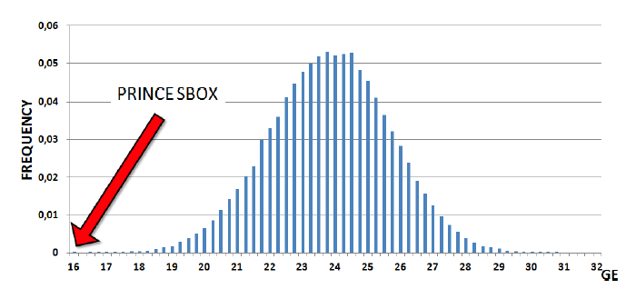
PRINCE: Sbox
64000 Sboxes (and their inverses) with good cryptographic criteria are implemented and synthesized to obtain average gate counts
Smallest Sbox selected
Area distribution of
good Sboxes (90 nm)

Slide 38
PRINCE: Area Results (kGE)

Slide 39
PRIDE: Target
A block cipher optimized for software implementations on widely-used embedded microprocessors
(e.g., Atmel ATmega8A)
Benchmark
SPECK-64/128 cipher of NSA* (also uses ATMega8A)
* Beaulieu et al, The Simon and Speck Families of Lightweight Block Ciphers, IACR ePrint Archive 2013/404, 2013

Slide 40
PRIDE: Key Figures
Bitslicing idea used in design
Brings additional permutation without any further effort
Substitution-permutation network
64-bit block, 128-bit key, 64-bit whitening keys
20 rounds
Last round different – no diffusion as it is not necessary

Slide 41
PRIDE: Design
Substitution-Permutation Network (SPN) adopted
Well-understood

Slide 42
PRIDE: Design
Linear layer: Expensive
One PRESENT round‘s linear layer cost:
Just wiring (no cost) in hardware
144 clock cycles in software (Atmel ATmega8A)

Slide 43
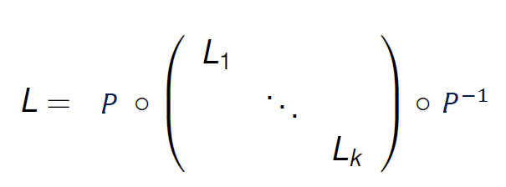
PRIDE: Design
Block interleaving construction

Slide 44
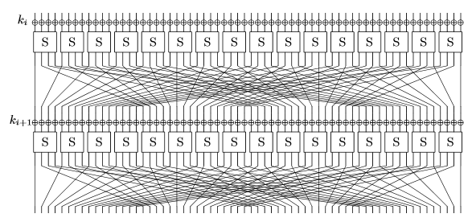
PRIDE: Bitslicing

Slide 45
PRIDE: Bitslicing

Slide 46
PRIDE: Bitslicing

Slide 47
PRIDE: Bitslicing

Slide 48
PRIDE: Bitslicing
…

Slide 49
PRIDE: Bitslicing
Sbox: ANF
a’ = f_{a}(a, b, c, d)
b’ = f_{b}(a, b, c, d)
c’ = f_{c}(a, b, c, d)
d’ = f_{d}(a, b, c, d)
…

Slide 50
PRIDE: Bitslicing
Additional permutation
Sbox: ANF
a’ = f_{a}(a, b, c, d)
b’ = f_{b}(a, b, c, d)
c’ = f_{c}(a, b, c, d)
d’ = f_{d}(a, b, c, d)
…

Slide 51
PRIDE: Implementation View

Slide 56
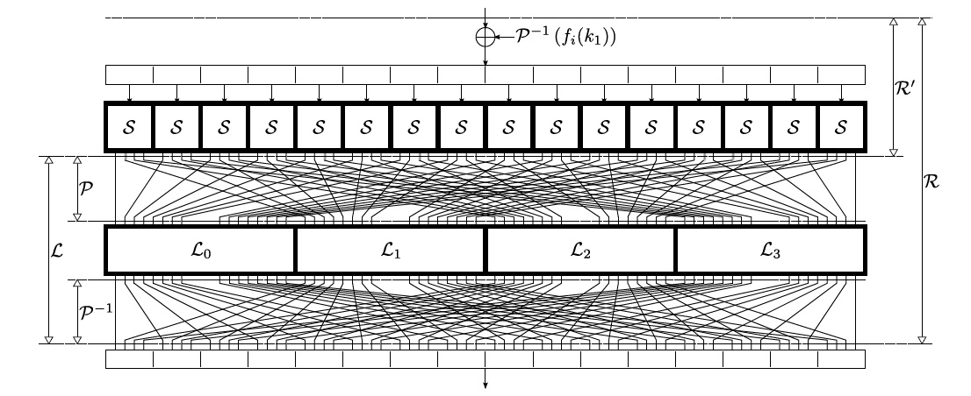

Slide 57
Permutation

Slide 58
Sbox
Permutation

Slide 59
Sbox
Permutation

Slide 60
Sbox
Permutation

Slide 61
Sbox
Permutation

Slide 62
Sbox
Permutation

Slide 63
4-bit
involution
Sbox
(formulation)

Slide 64
4-bit
involution
Sbox
(formulation)
R0’ = R4 XOR (R0 AND R2)
R2’ = R6 XOR (R2 AND R4)
R4’ = R0 XOR (R0’ AND R2’)
R6’ = R2 XOR (R2’ AND R4’)
10 instructions

Slide 65
4-bit
involution
Sbox
(formulation)
R0’ = R4 XOR (R0 AND R2)
R2’ = R6 XOR (R2 AND R4)
R4’ = R0 XOR (R0’ AND R2’)
R6’ = R2 XOR (R2’ AND R4’)
R1’ = R5 XOR (R1 AND R2)
R3’ = R7 XOR (R3 AND R5)
R5’ = R1 XOR (R1’ AND R3’)
R7’ = R3 XOR (R3’ AND R5’)
10 instructions
10 instructions

Slide 66
4-bit
involution
Sbox
(formulation)

Slide 67
Linear Layer

Slide 68
Linear Layer
L₀

Slide 69
Linear Layer
L₀
L₁

Slide 70
Linear Layer
L₀
L₁
L₂

Slide 71
Linear Layer
L₀
L₁
L₂
L₃

Slide 72
Linear Layer
L₀
L₁
L₂
L₃
16 x 16 matrices!

Slide 73
Linear Layer
L₀
L₁
L₂
L₃
16 x 16 matrices!
Should not be very costly: Look for efficiently implementable L_{i}!

Slide 74
PRIDE: How to Choose L_{i}
Looking for “the cheapest implementation of a given linear layer L”?

Slide 75
PRIDE: How to Choose L_{i}
Looking for “the cheapest implementation of a given linear layer L”?
NO!
Instead...
“Which good linear layer can be implemented with ‘N‘ minimum instructions”?
In turn it gives us also...
# of clock cycles for speed
#of bytes for code size

Slide 76
PRIDE: How to Choose L_{i}
Focus on smaller linear layers L_{i} – Block interleaving helps!
Reduces the search space
Search for ‘efficient‘ permutation matrices
Look for 4 efficiently-implementable 16x16 binary permutation matrices
Similar to Sbox search of Ullrich et al.*
Search performed on hardware platform instead of software platform
Faster search, larger search space
* Ullrich et al., Finding Optimal Bitsliced Implementations of 4 x 4-bit S-boxes, SKEW 2011

Slide 77
PRIDE: Search on Hardware
Search in a subset of possible 16 x 16 matrices using an FPGA
16 x 16 still quite large...
L_{i}
8 x 8

Slide 78
Limit number of instructions
CLC, EOR, MOV, MOVW, CLR, SWAP, ASR, ROR, ROL, LSR, LSL
Limit number of used registers
2 state, 4 temporary registers
Try all possible combinations of instructions and registers
Save the matrices generating appropriate code
Out of these, look for the ones with least instructions
Ended up with 36 instructions for the whole linear layer!
L₀=7, L₁=11, L₂=7, L₃=11, L₀⁻¹=7, L₁⁻¹=13, L₂⁻¹=7, L₃⁻¹=13

Slide 79
PRIDE: Results
One Round Cost | Key Update | Key Addition | Sbox Layer | Linear Layer | Total
Time (Clock Cycles) | 4 | 8 | 20 | 36 | 68
Code Size (Bytes) | 8 | 16 | 40 | 72 | 136

Slide 80
 | AES-128 | SERPENT-128 | PRESENT-128 | CLEFIA-128 | SEA-96 | NOEKEON-128 | PRINCE-128 | ITUBee-80 | SIMON-64/128* | SPECK-64/96* | SPECK-64/128* | PRIDE
Time (Clock Cycles) | 3159 | 49314 | 10792 | 28648 | 17745 | 23517 | 3614 | 2607 | 2000 | 1152 | 1200 | 1514
Code Size (Bytes) | 1570 | 7220 | 660 | 3046 | 386 | 364 | 1108 | 716 | 282 | 182 | 186 | 266
* Data & key read-write omitted
Performance on Atmel AVR 8- bit microcontroller (encryption)
PRIDE decryption: 1570 clock cycles and 282 bytes
Results close to SPECK
Good results for a “traditional” design

Slide 81
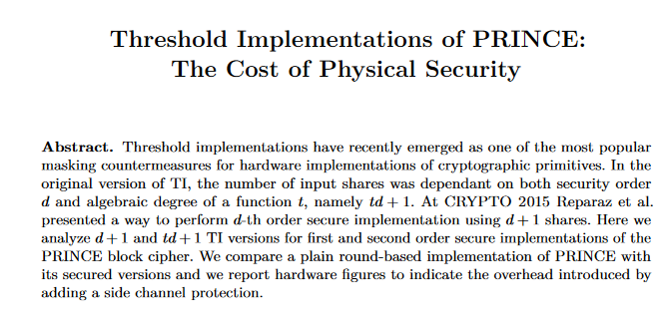
Threshold Implementation: PRINCE
Bozilov et al (KU Leuven) at LWC Workshop 2016

Slide 82
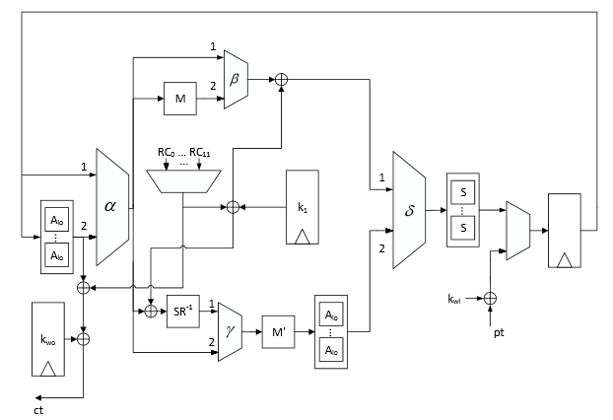
Applied on PRINCE Sbox: Algebraic degree 3, Class Q₂₉₄
Unprotected, round-based PRINCE
Notes:
Mention affine transformations.
Separating nonlinear operations means 3 clock cycles for single PRINCE Sbox call.

Slide 83
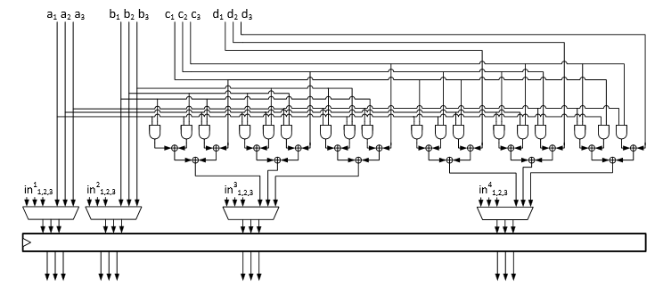
Class Q₂₉₄ sharing, first-order secure, 3 by 3 sharing
No re-masking, sharing is uniform

Slide 84
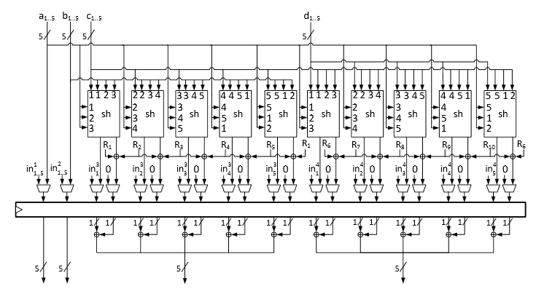
Class Q₂₉₄ sharing, second-order secure, 5 by 10 sharing
Re-masking applied

Slide 85
PRINCE-128 (round-based implementation) unprotected
PRINCE-128 (round-based implementation) 1st-order secure
PRINCE-128 (round-based implementation) 2nd-order secure
Technology | Area (GE)
ASIC, 90nm | 3589
Technology | Area (GE)
ASIC, 90nm | 11958
Technology | Area (GE)
ASIC, 90nm | 21879
Notes:
Results better than our back-the-envelope 1st order estimations (~20k)
No evaluation available.

Slide 86
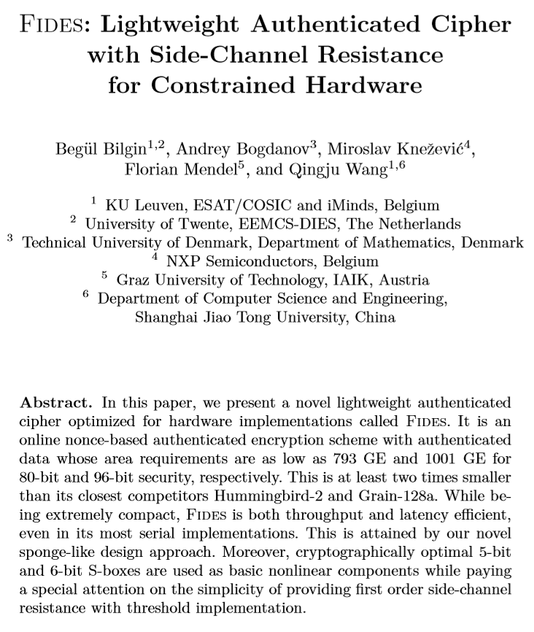
Side-channel Resistant Resource-efficient Block Ciphers

Slide 87
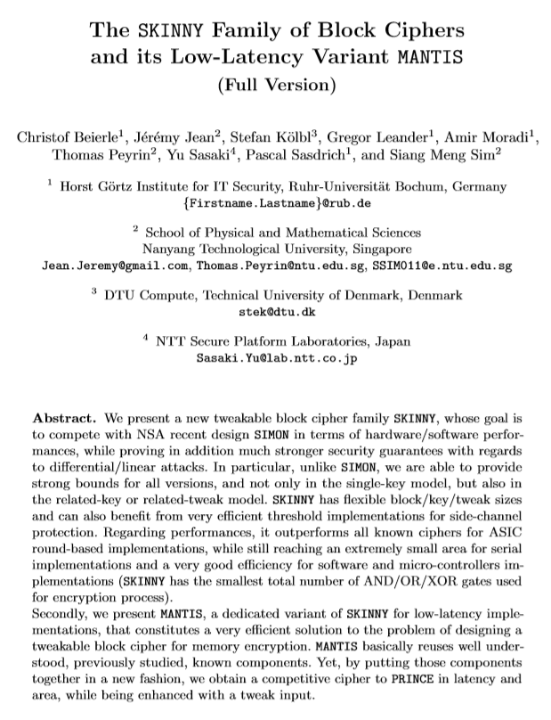
Side-channel Resistant Resource-efficient Block Ciphers

Slide 88
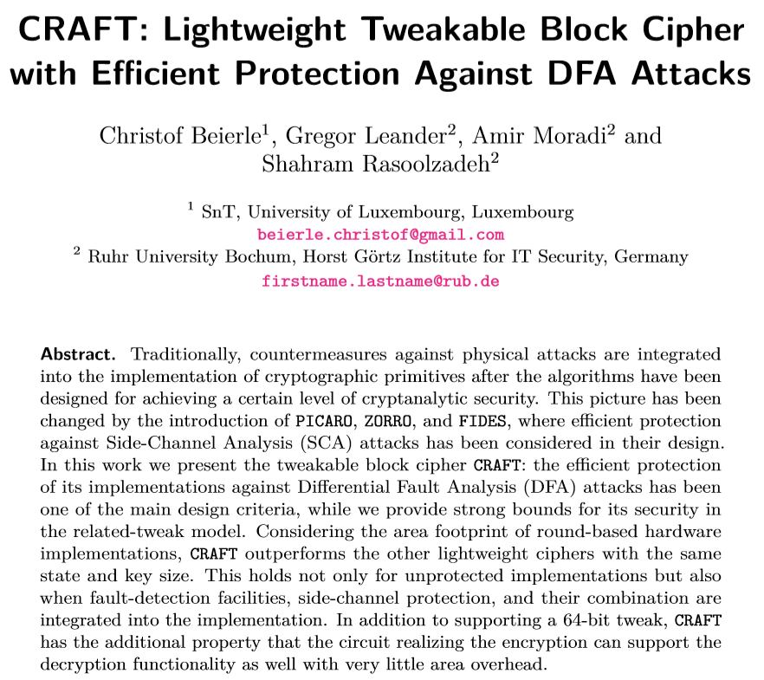
Side-channel Resistant Resource-efficient Block Ciphers

Slide 89
Thanks for listening.
Any questions?

